Slide 1
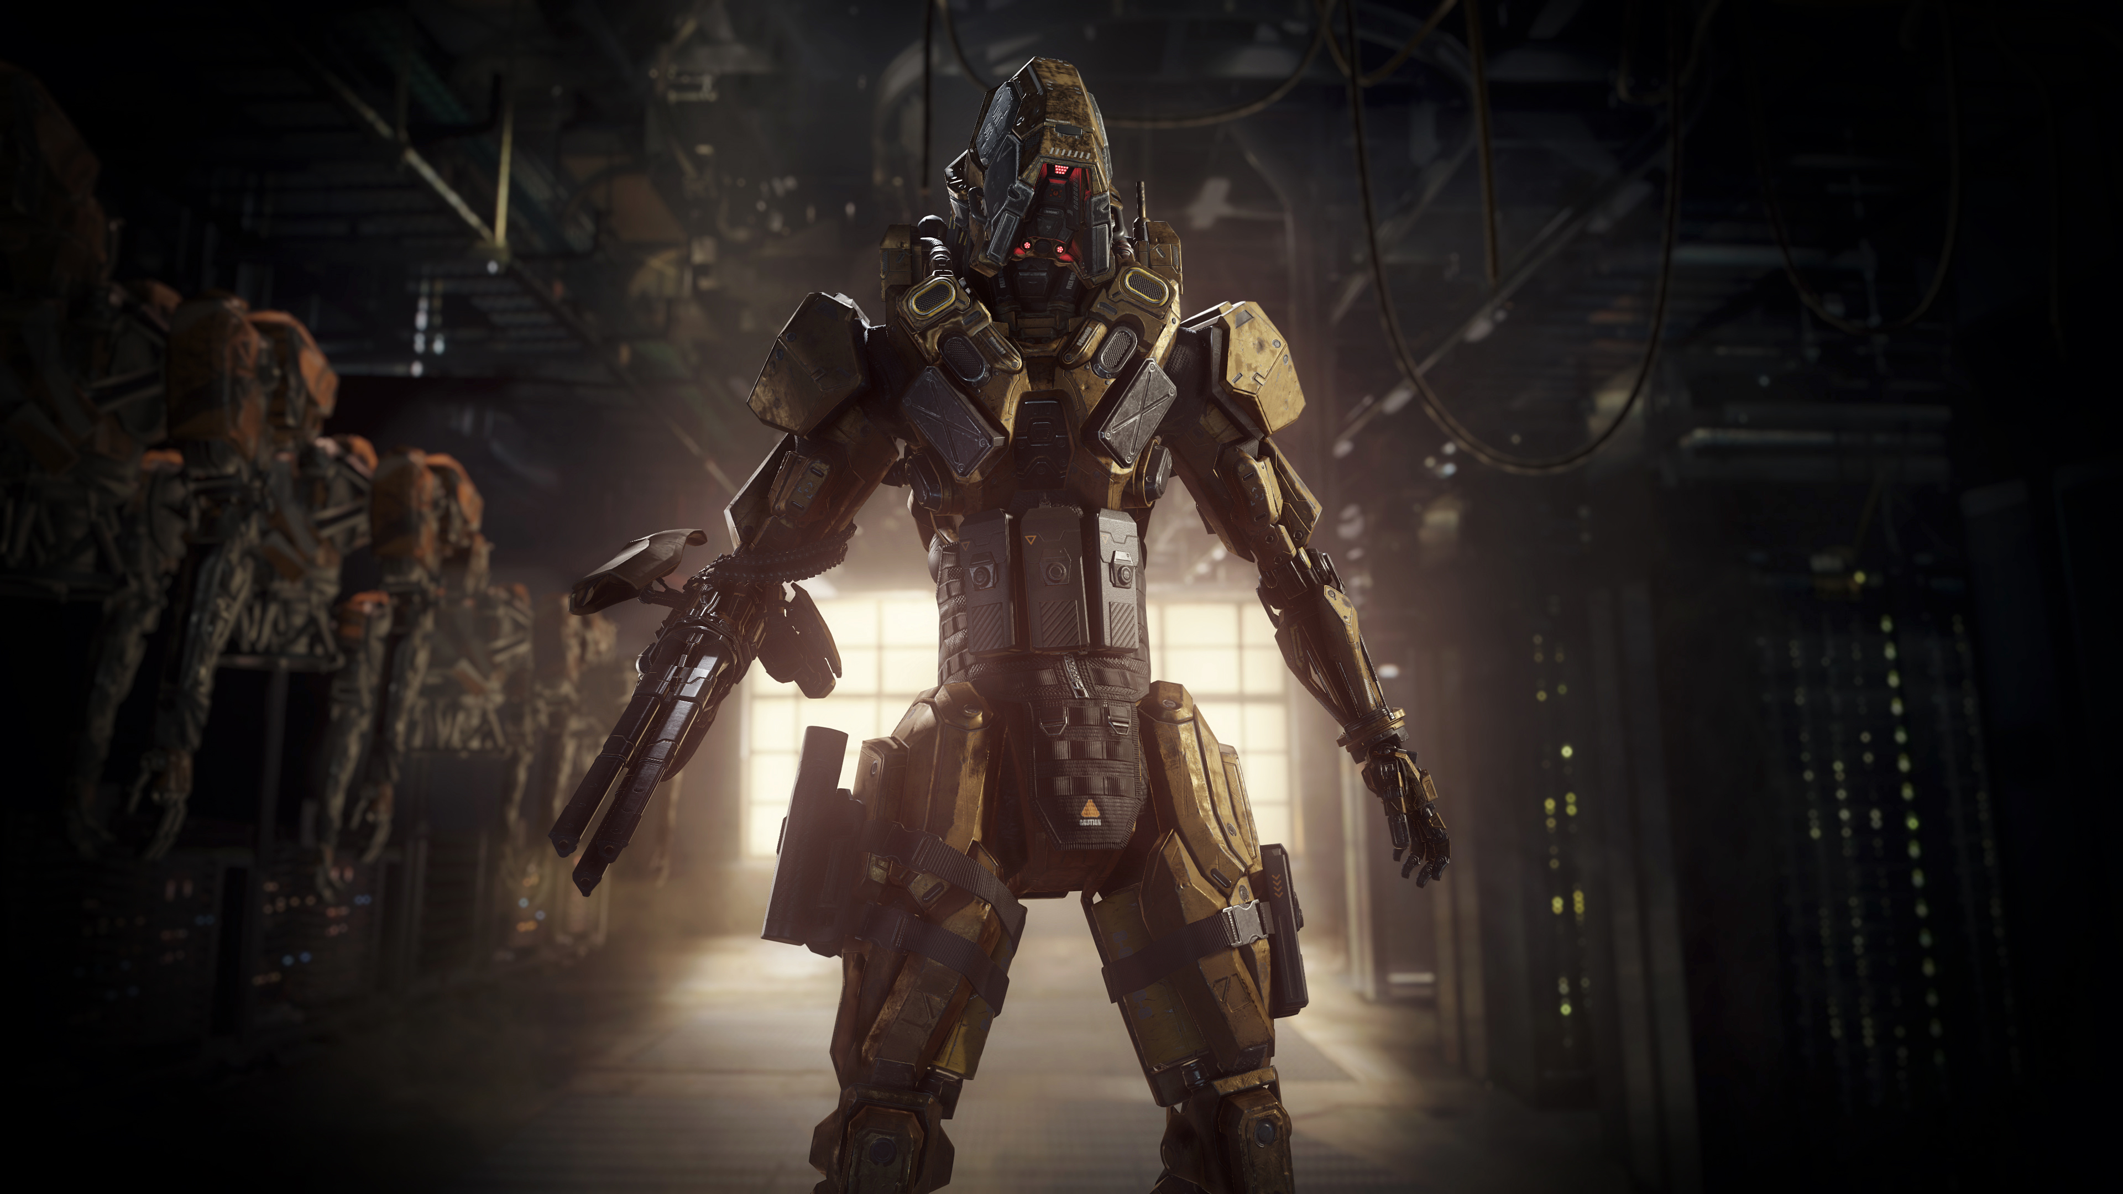


Filmic SMAA Sharp Morphological and Temporal Antialiasing
Jorge Jimenez – Graphics R&D Technical Director (Activision Blizzard)
Advances in Real-Time Rendering course
Notes:
Hi,
Thanks for the introduction.
So, I’ll be talking about
Filmic SMAA.
It has been 3 years now since the last release of SMAA.
Since then, we have seen substantial improvements in temporal AA,
some of them in past editions of this course.
During this time we’ve also been working on improving SMAA, in both its morphological and temporal components.
In this presentation I’ll be covering these improvements,
how SMAA adopted some of the most useful ideas in the current state of the art,
and how we improved upon some of them.

Slide 2
Notice for Offline Reading
Hidden slides in this presentation
Slide show mode won’t show them
Don’t miss the speaker notes, most slides have them
Movies typically contain a red/green bar on the bottom
Red means without a feature
Green means with it
Movie progress bar might hide this bar if not seen in fullscreen mode

Slide 3
SMAA Goals
Sharpness
Notes:
The first goal of SMAA has always been to preserve image sharpness.
Both morphological and temporal can potentially blur the image, and this is an effect that stacks up,
and can end up being very noticeable in the end.
Because of this, every feature that we have introduced for both morphological and temporal antialiasing
has been tuned to preserve image sharpness as much as possible.

Slide 4
SMAA Goals
Sharpness
Robustness
Notes:
The second goal is robustness.
Temporal antialiasing can have a striking effect on image quality.
But unfortunately can also come with unwanted side effects,
both in terms of losing sharpness and also introducing ghosting, or even flickering.
So we have improved our temporal antialiasing solution to minimize its side effects,
while still getting the full antialiasing benefits.

Slide 5
SMAA Goals
Sharpness
Robustness
Performance
0.75-1.05ms on a PS4@1080p
Includes most of what is included in this presentation
Notes:
And finally, we worked to pack all these features in a reasonable budget
of 0.75 to 1.05ms @1080p on a PS4.
Most of the features that will be presented add incremental performance and quality improvements,
but all together made Filmic SMAA a substantially faster and sharper technique.
The final version is actually two times faster than our original implementation, with substantially better quality.

Slide 6
What is Filmic SMAA?
Morphological antialiasing (SMAA 1x)
+ Temporal supersampling (SMAA T2x)
+ Spatial multisampling (SMAA S2x) – not practical for our games
Combined (SMAA 4x) – not practical for our games
Notes:
So, before I continue, I’d like to do a recap of SMAA, and introduce the new mode, which we called Filmic.
The core of SMAA is a morphological component, which is what we called SMAA 1x.
Then on top of that we can add temporal supersampling, which is SMAA T2x.
We also have modes that exploit multisampling, but we won’t be covering them here.

Slide 7
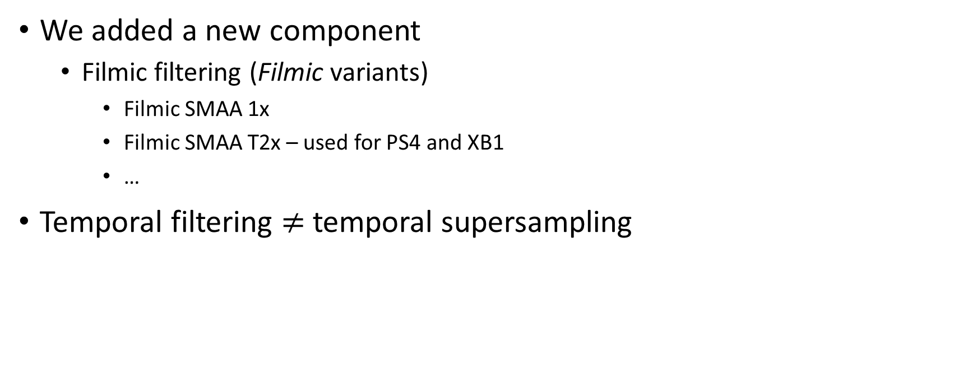
What is Filmic SMAA?
We added a new component
Filmic filtering (Filmic variants)
Filmic SMAA 1x
Filmic SMAA T2x – used for PS4 and XB1
…
Temporal filtering $≠$ temporal supersampling
Notes:
So, the new component, which we called filmic,
applies a temporal filtering pass that can be applied on top of the other modes.
As we will see later on, we have divided the temporal component into supersampling and filtering,
which provides additional benefits over performing them together.
In this talk we be focusing on Filmic SMAA T2x, which is what we used in production for consoles.

Slide 8
Morphological
Notes:
The first part of the talk will be about some of the morphological improvements that we have made since the last SMAA release.

Slide 9
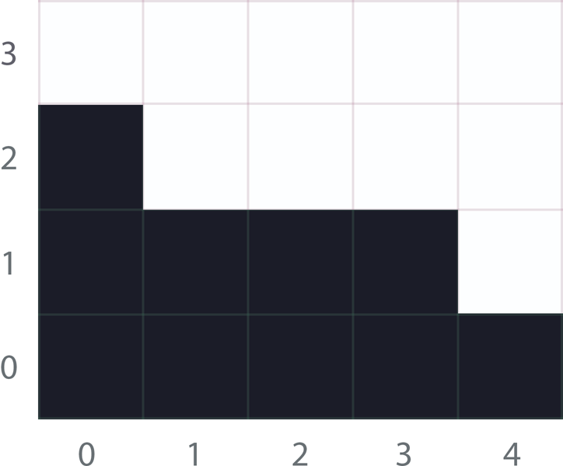
Morphological Antialiasing Basics
Notes:
But I’d like to cover the basics first.
The way that morphological antialiasing works is by trying to figure out the pattern that generated a given rasterized image.
Then it essentially rasterizes the image again, but in this case with antialiasing.
So, say we want to antialias this image.

Slide 10
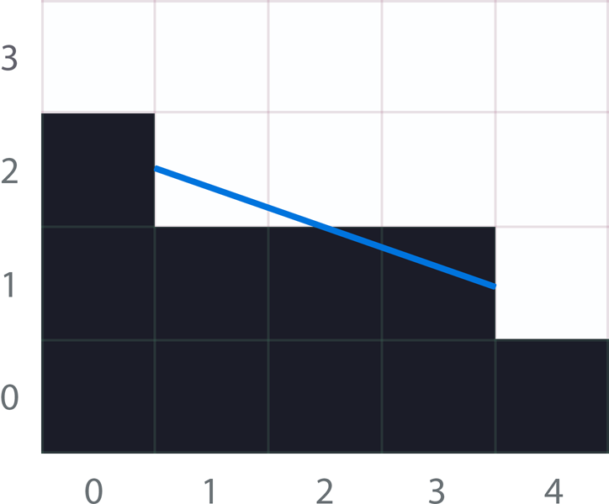
Morphological Antialiasing Basics
Notes:
For this we have to figure out the blue line,
which represents the revectorization of this pixel pattern.

Slide 11
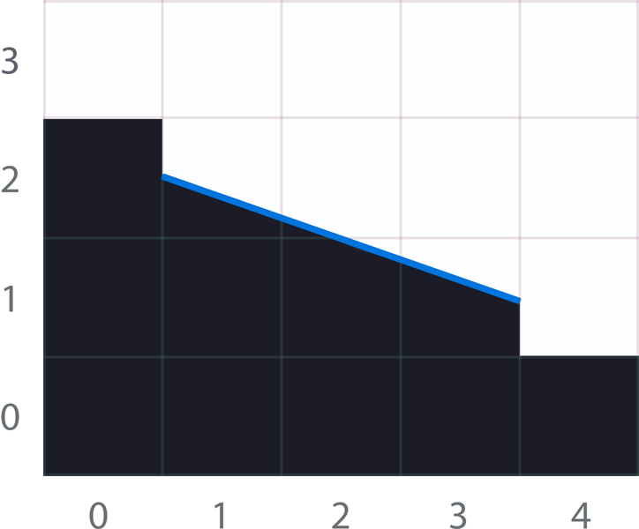
Morphological Antialiasing Basics
Notes:
Using this revectorization, we will fill the areas under the line using the opposite color at each pixel.
This is then translated to…

Slide 12
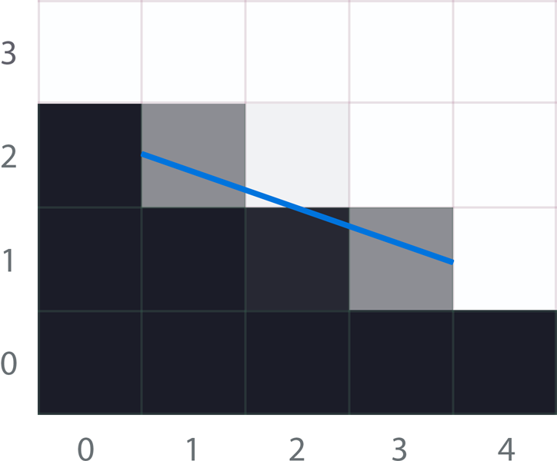
Morphological Antialiasing Basics
Notes:
…gray levels, which approximate the real shape for the resolution that we have.

Slide 13
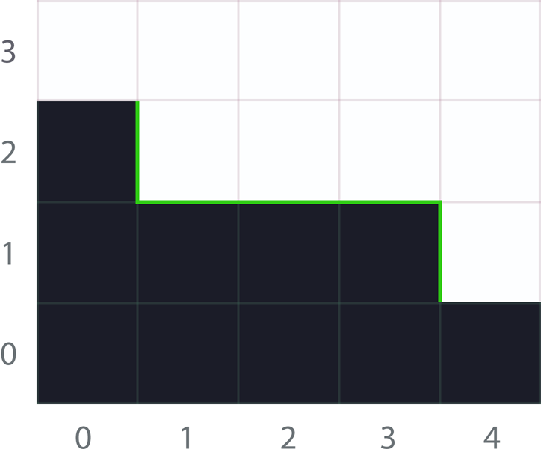
Morphological Antialiasing Basics
Notes:
But, ok, let’s rewind.
The first step is detecting where the edges are, which are the lines marked on green.

Slide 14
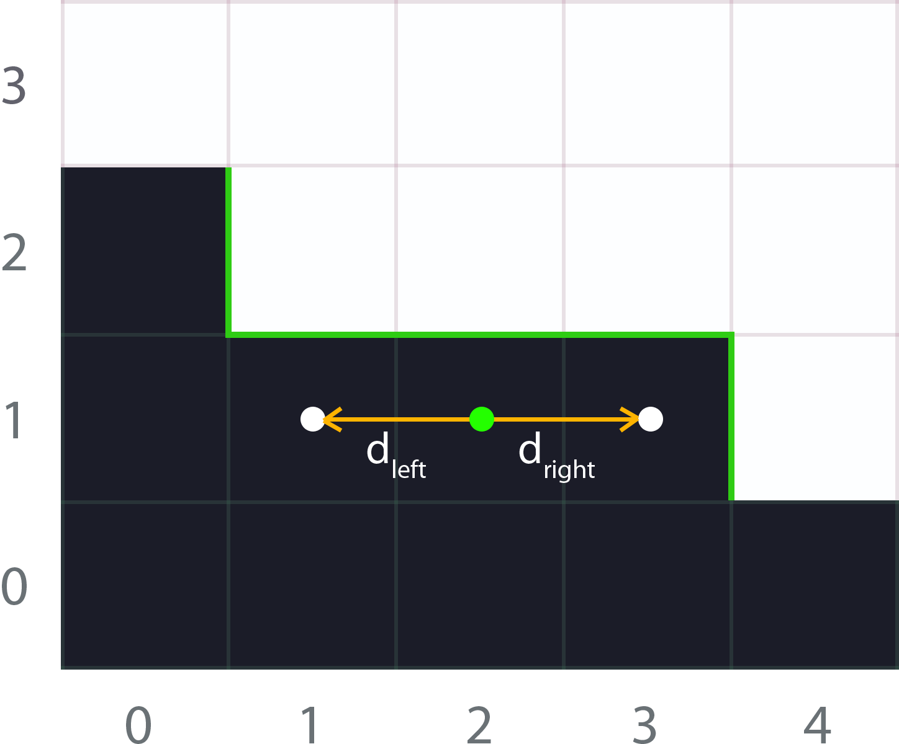
Morphological Antialiasing Basics
Notes:
And now, we have to search for the line ends to the left and to the right.

Slide 15
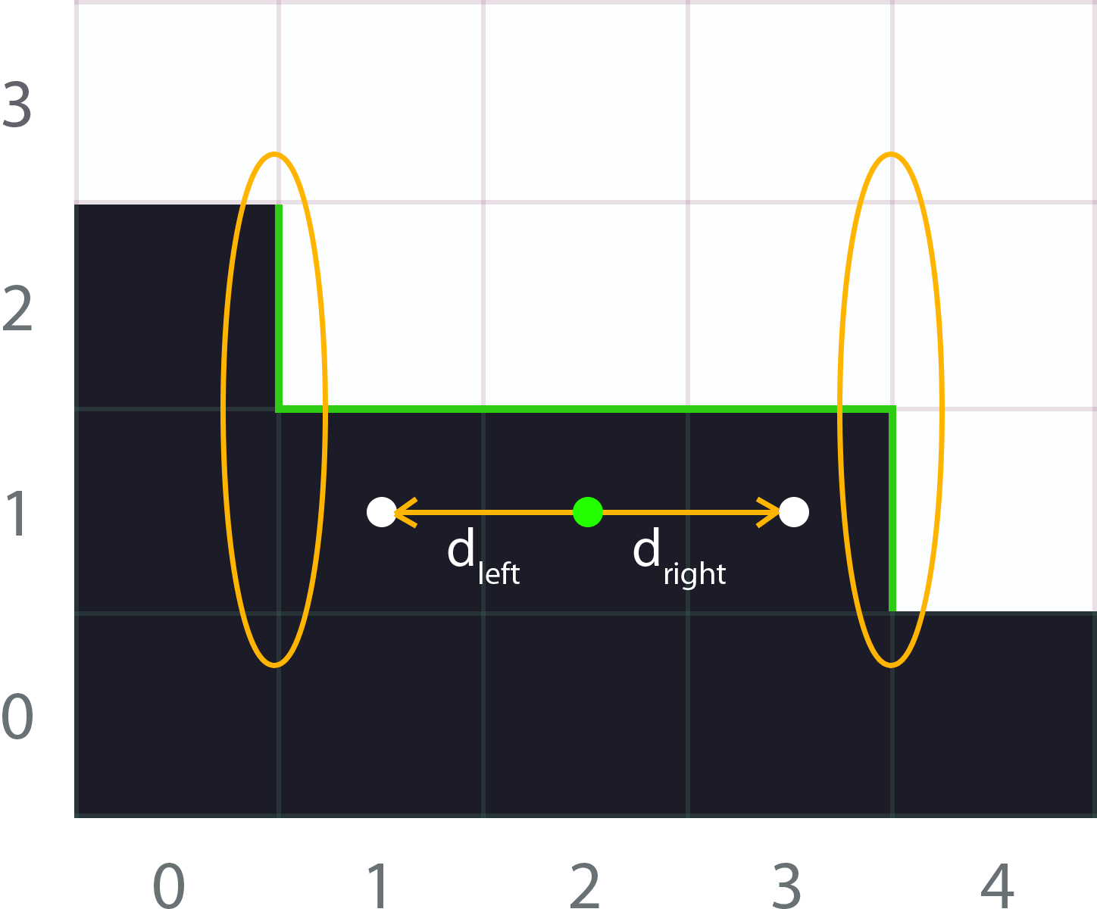
Morphological Antialiasing Basics
Notes:
And then, obtain the crossing edges at each side of the line.

Slide 16
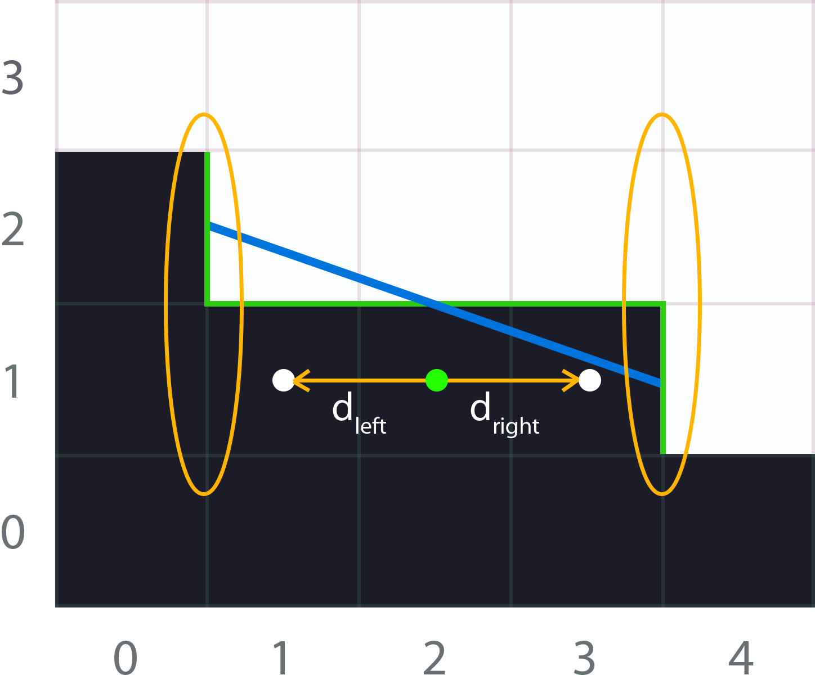
Morphological Antialiasing Basics
Notes:
With the distances and crossing edges at hand, we have enough information for calculating the areas under the revectorized line.

Slide 17
Morphological Antialiasing Improvements
Quality
Performance
Morphological edge suppression
Silhouette line detection
U-shape smoothing
Deferred queues
Using the LDS
Dual edge blending
Notes:
So that was the morphological basics.
And here we have the quality and performance improvements done over this technique.
From all of them, we will be focusing on…

Slide 18
Morphological Antialiasing Improvements
Quality
Performance
Morphological edge suppression
Silhouette line detection
U-shape smoothing
Deferred queues
Using the LDS
Dual edge blending
Notes:
…these ones.
But you can find the rest on the online slides.

Slide 19
Morphological: Quality
Notes:
So, let’s start with some quality improvements.

Slide 20
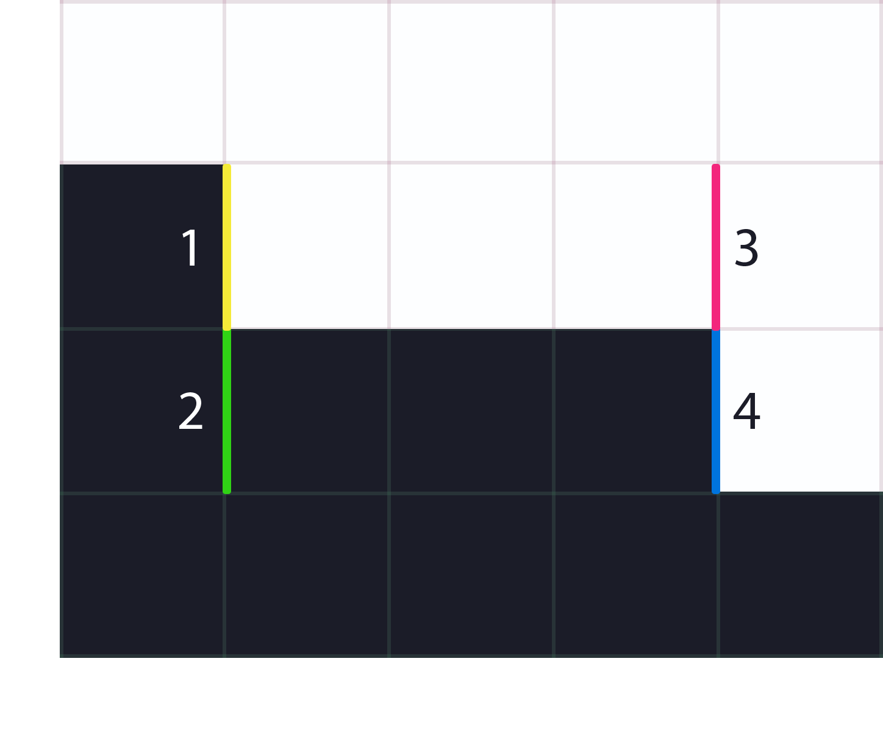
Recap: Local Contrast Edge Suppression
Searching for ends
We stop at Crossing Edges
Notes:
The way morphological antialiasing works is by searching for lines ends and then to detect patterns,
as we mentioned.
So, when searching for lines, we for example follow this green line on the image in the left.
If the green lines finishes, or we find a crossing edge, as you can see in the right, we stop the search.

Slide 21
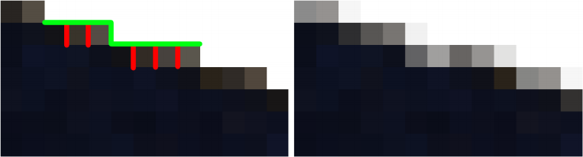
Recap: Local Contrast Edge Suppression
Input + Edge Overlay
Morphological Output
Notes:
So, in the image in the left, we have the input image.
The problem here is that it contains small color differences that are triggering spurious crossing edges,
marked in red, and those break the line search earlier than what we’d like.
You can see that the dominant pattern is the one marked in green,
and that is what our vision system truly recognizes.

Slide 22
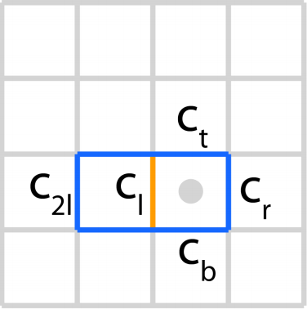
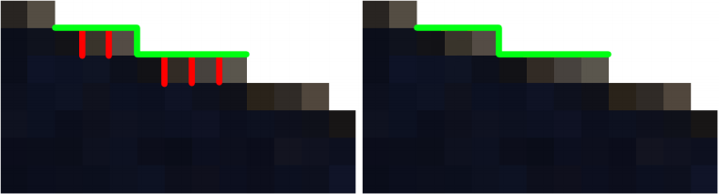
Recap: Local Contrast Edge Suppression
Before local contrast detection
After local contrast detection
Notes:
To solve this, we introduced in the original SMAA,
a simple technique that we called local contrast edge suppression.
For a given edge, like the one marked in red on the figure in the right,
we check the neighborhood edges,
and we suppress it if we find other edge that dominates it in terms of contrast.

Slide 23
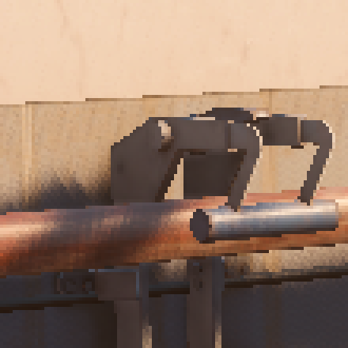
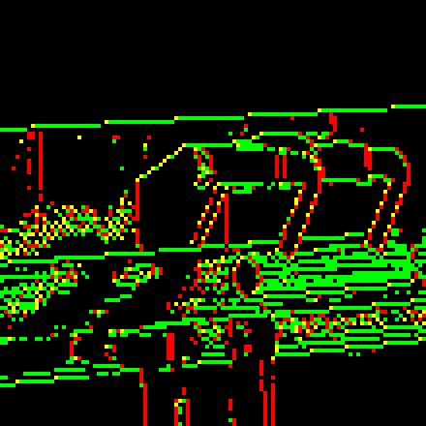
Failure Case
Input
Edges
Notes:
Unfortunately, this has a failure case that makes the line search to fail sometimes.
So, let me zoom in so that we can more clearly see what is going on here.

Slide 24

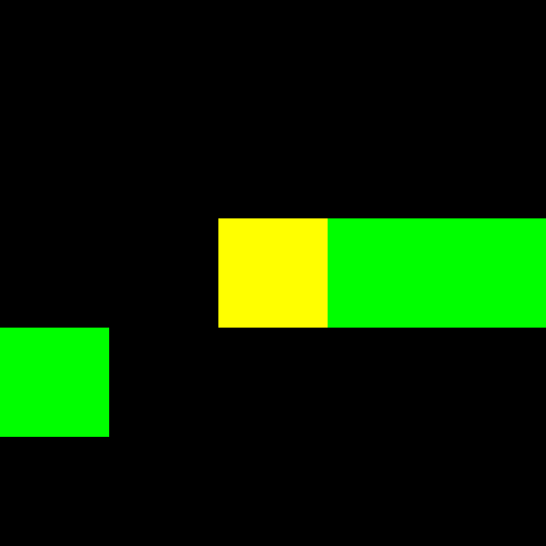
Failure Case
Input
Edges
Notes:
The problem here, is that sometimes even if an edge is much stronger than other,
it doesn’t lead to any meaningful pattern.

Slide 25
Failure Case
Local Contrast Edge Suppression
Input
Edges
Notes:
So, for example here the edge marked in the red
is being suppressed by the edge in green
because of the much higher contrast.

Slide 26
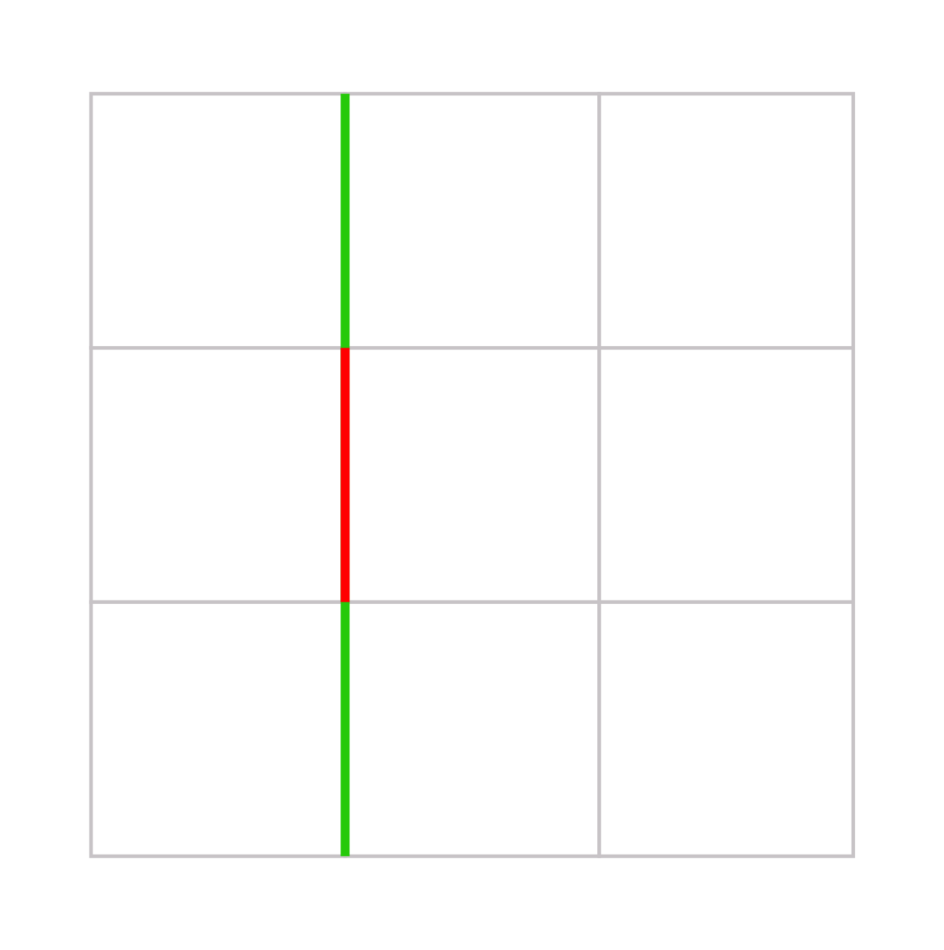
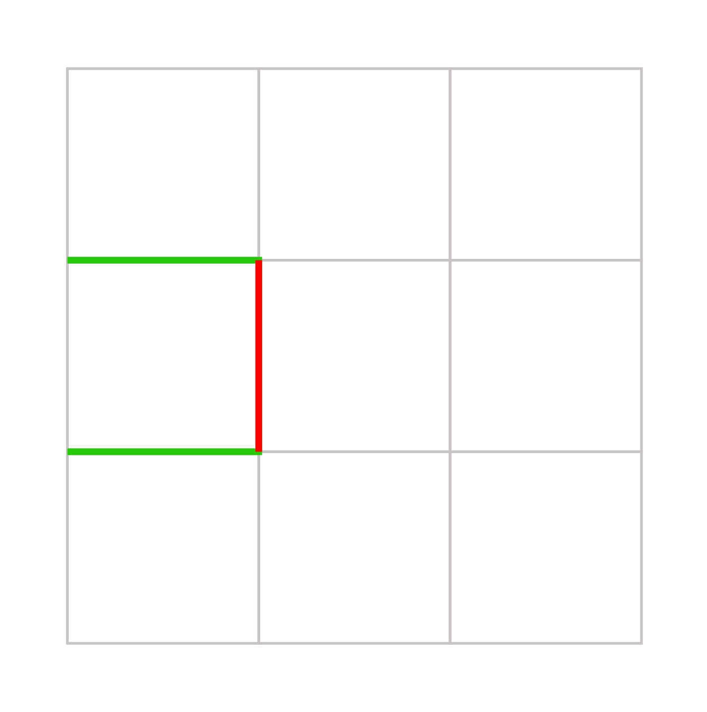
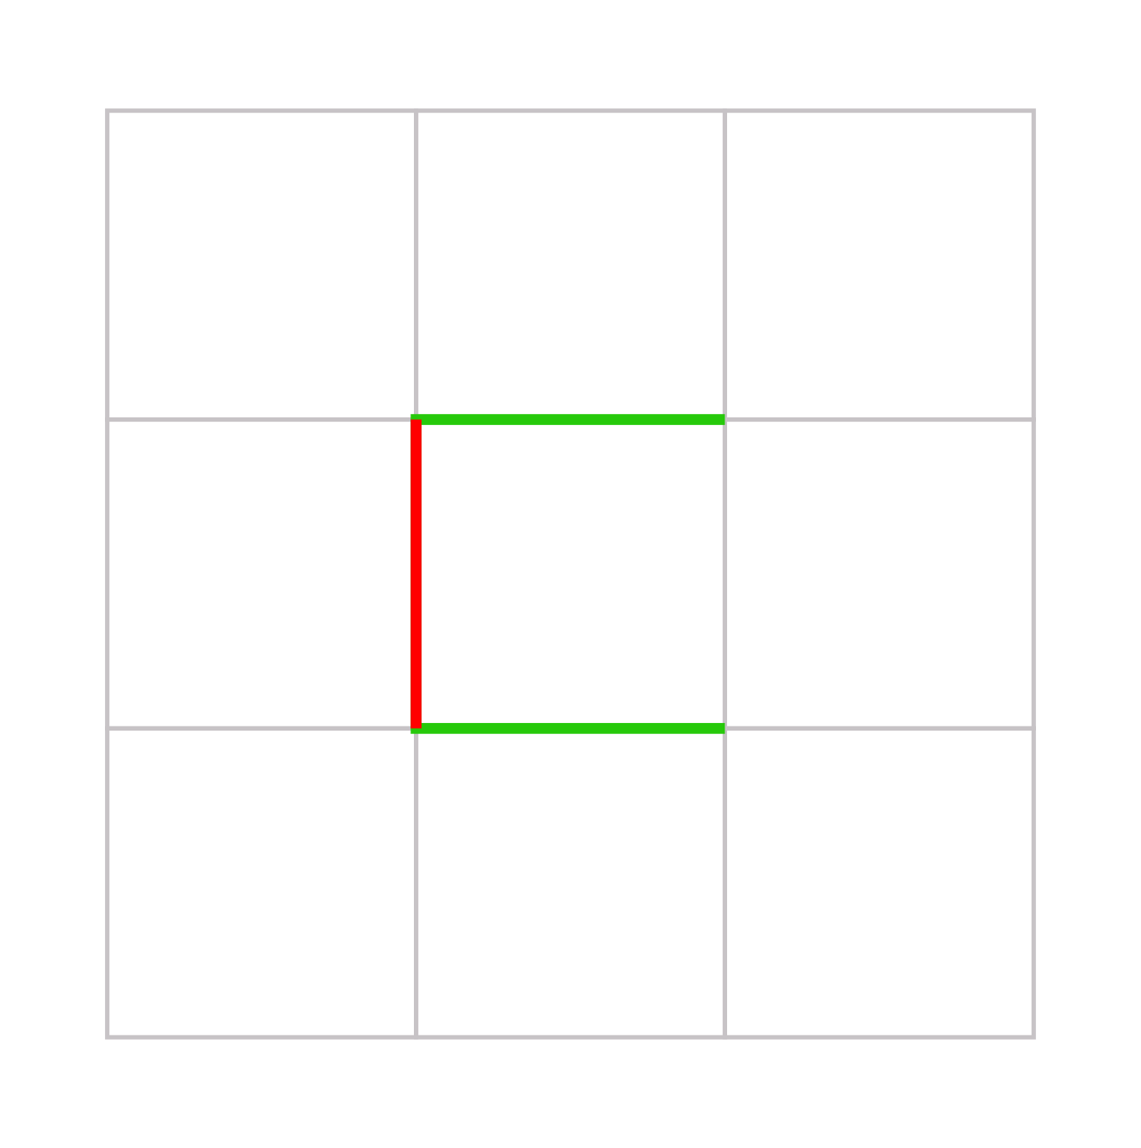
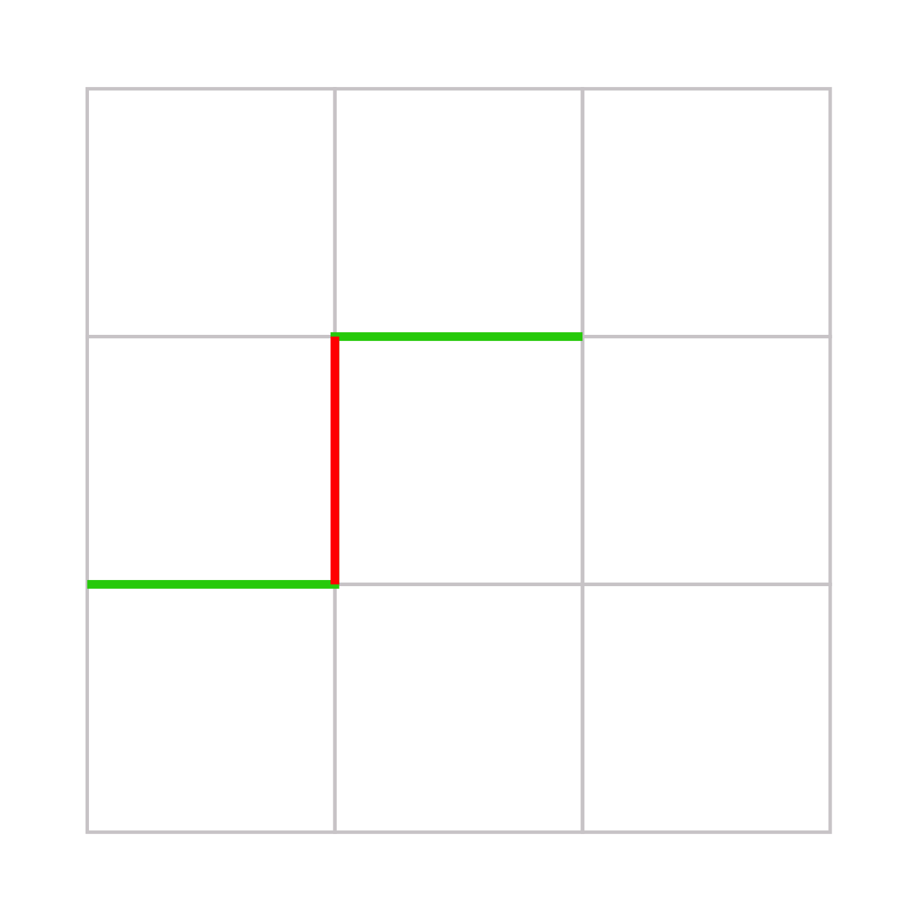
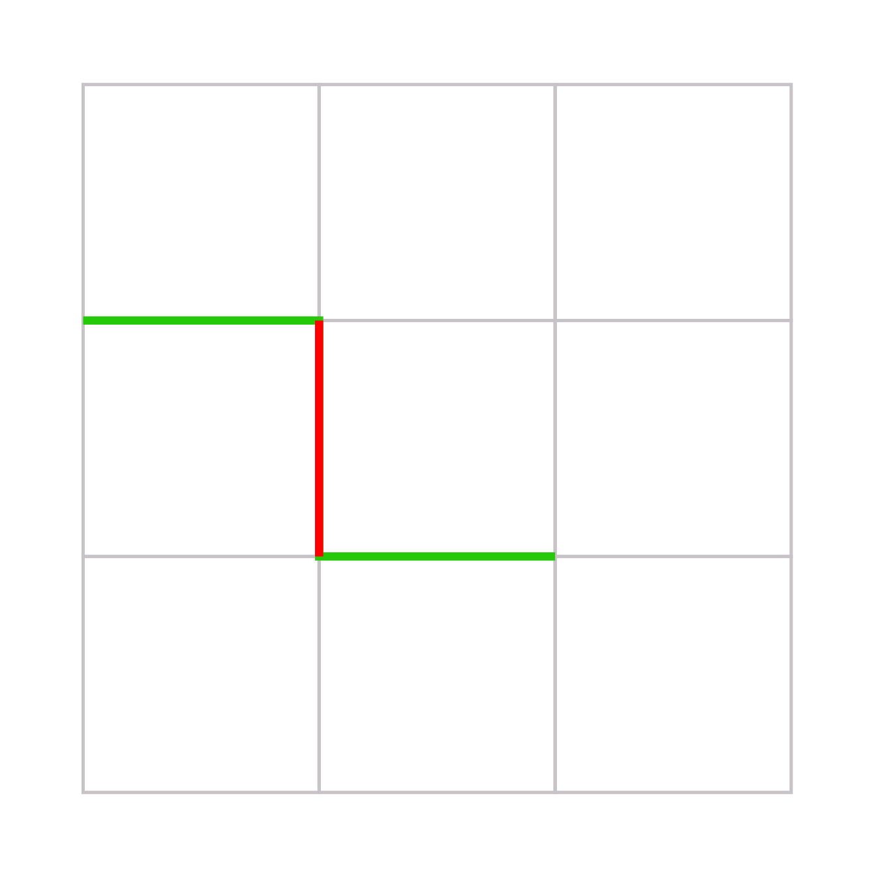
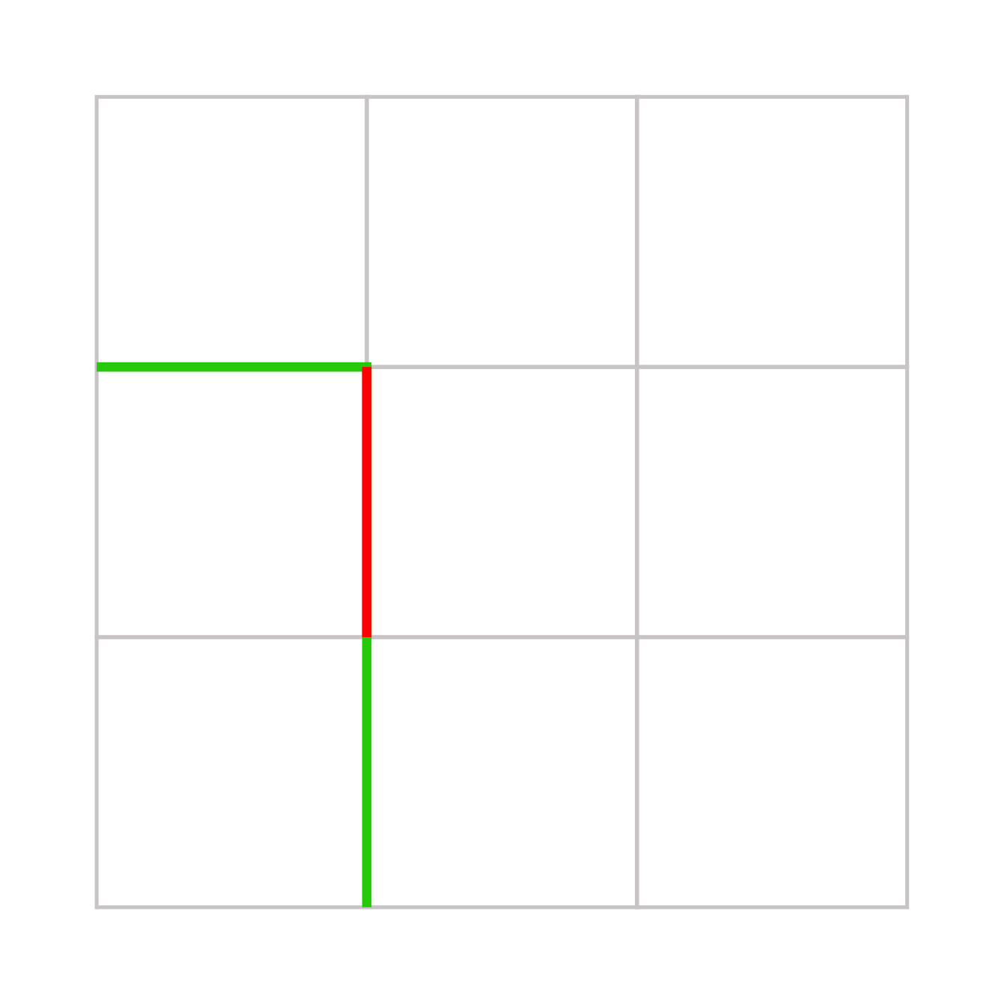
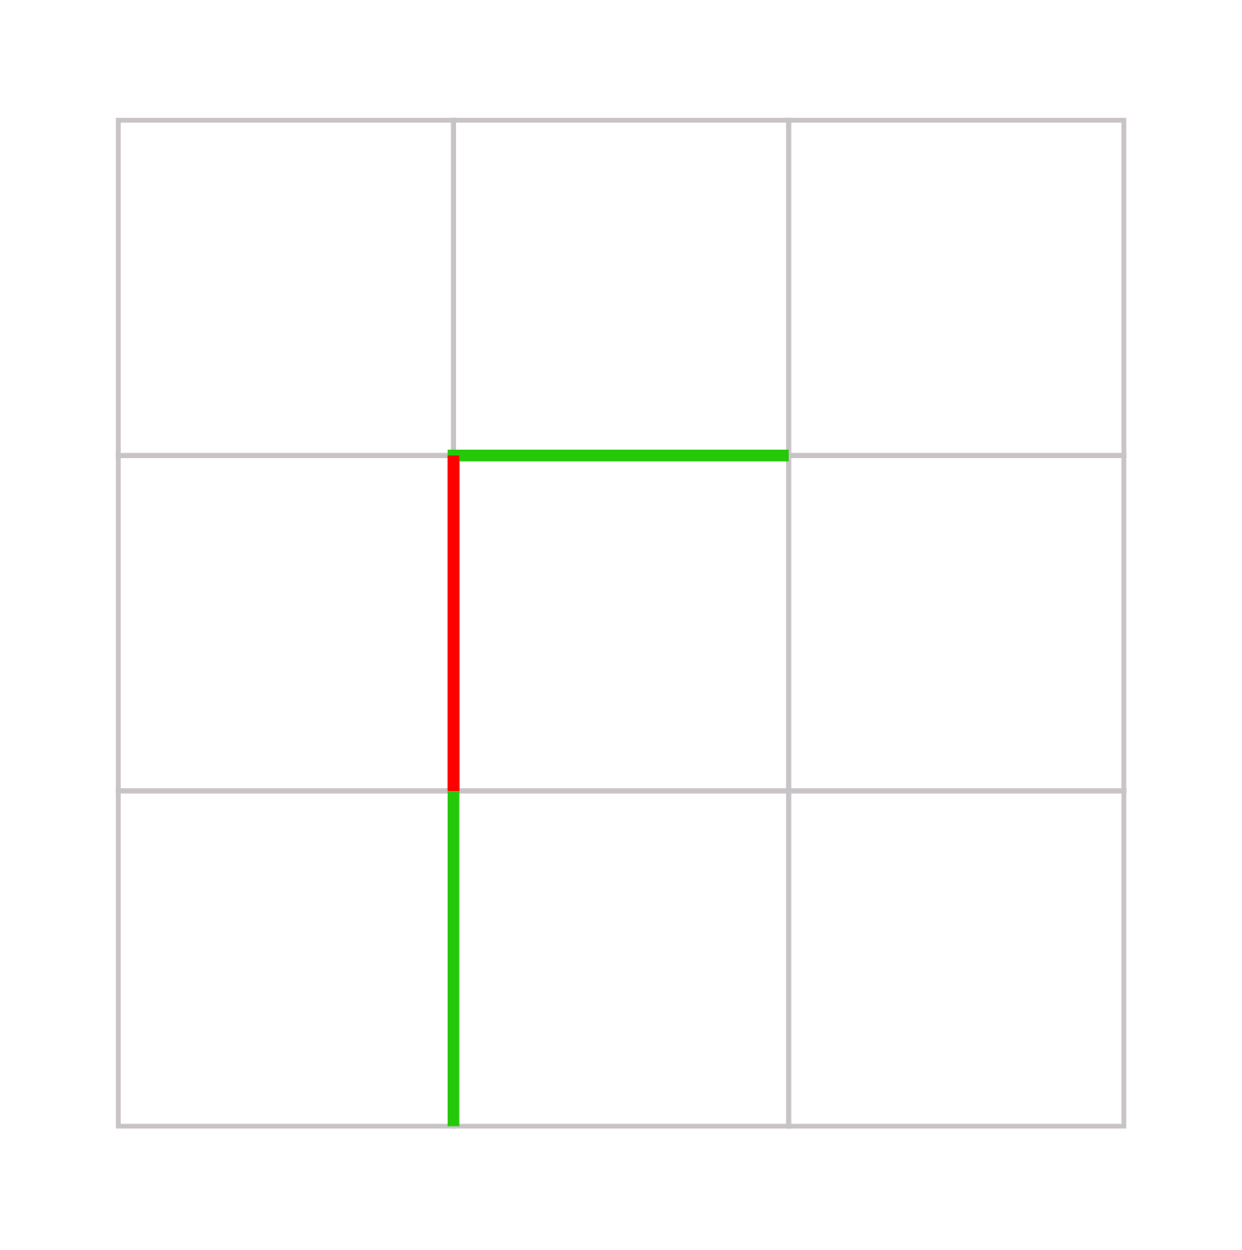
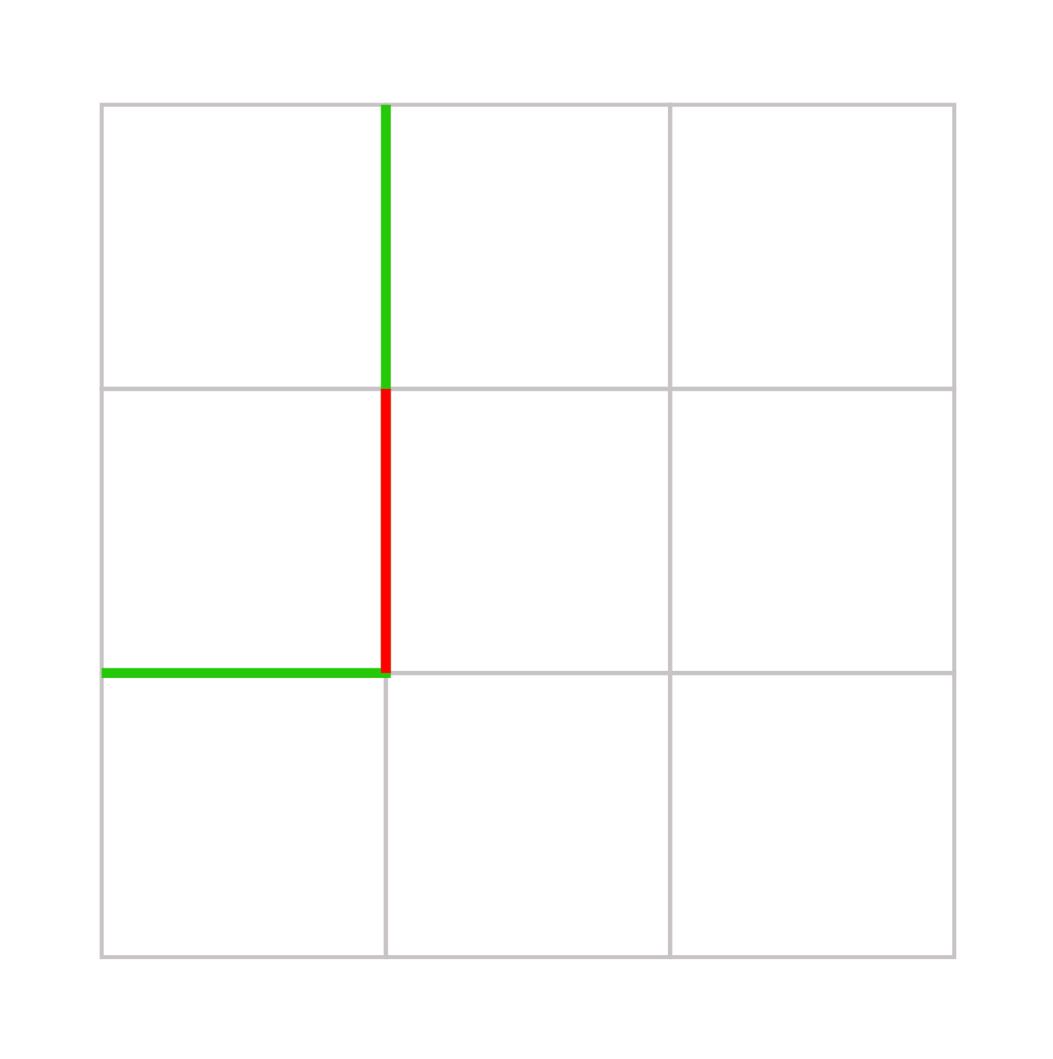
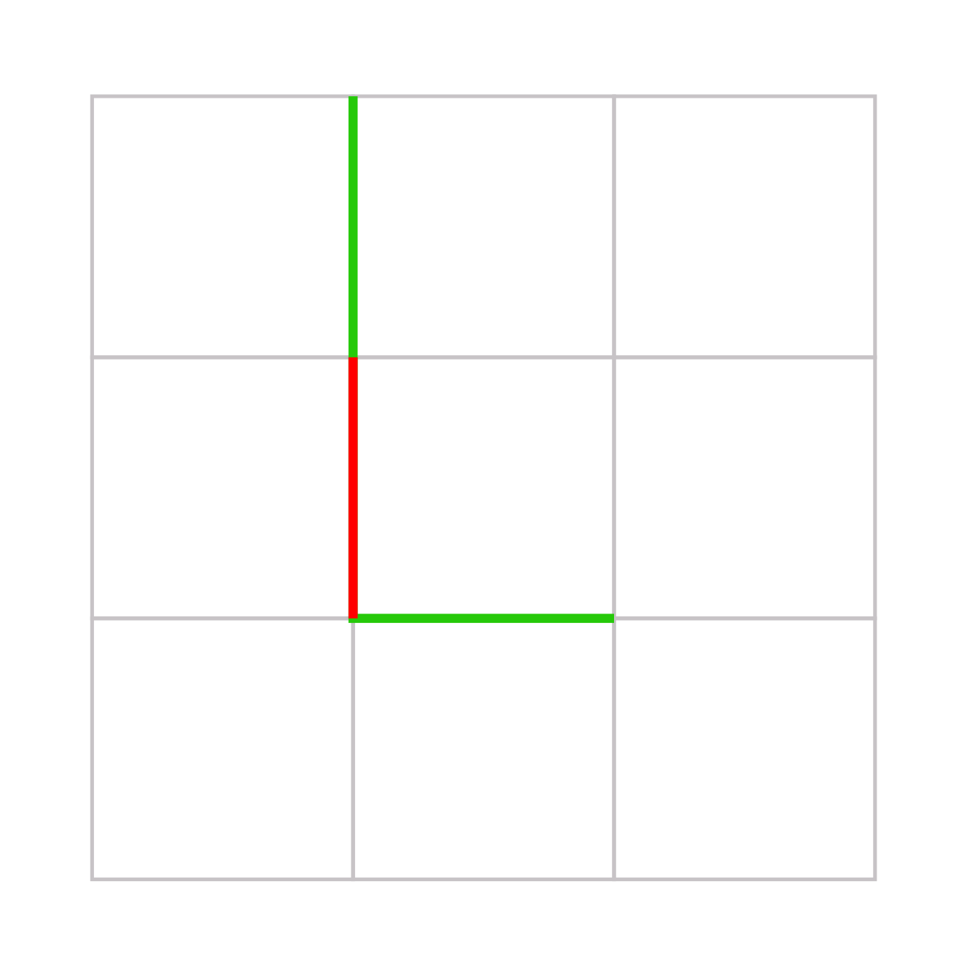
Morphological Edge Suppression
Search for all patterns that can be passing through current edge
Notes:
So, here we have the new approach to this problem.
We tried to better mimic how our vision system perceives patterns,
as it is not just a matter contrast for a single edge,
but we rather perform an early pattern matching during edge detection.
For this, we first search for all patterns that pass through current edge, marked in red.
We then score the patterns accumulating the absolute differences of their edges.

Slide 27
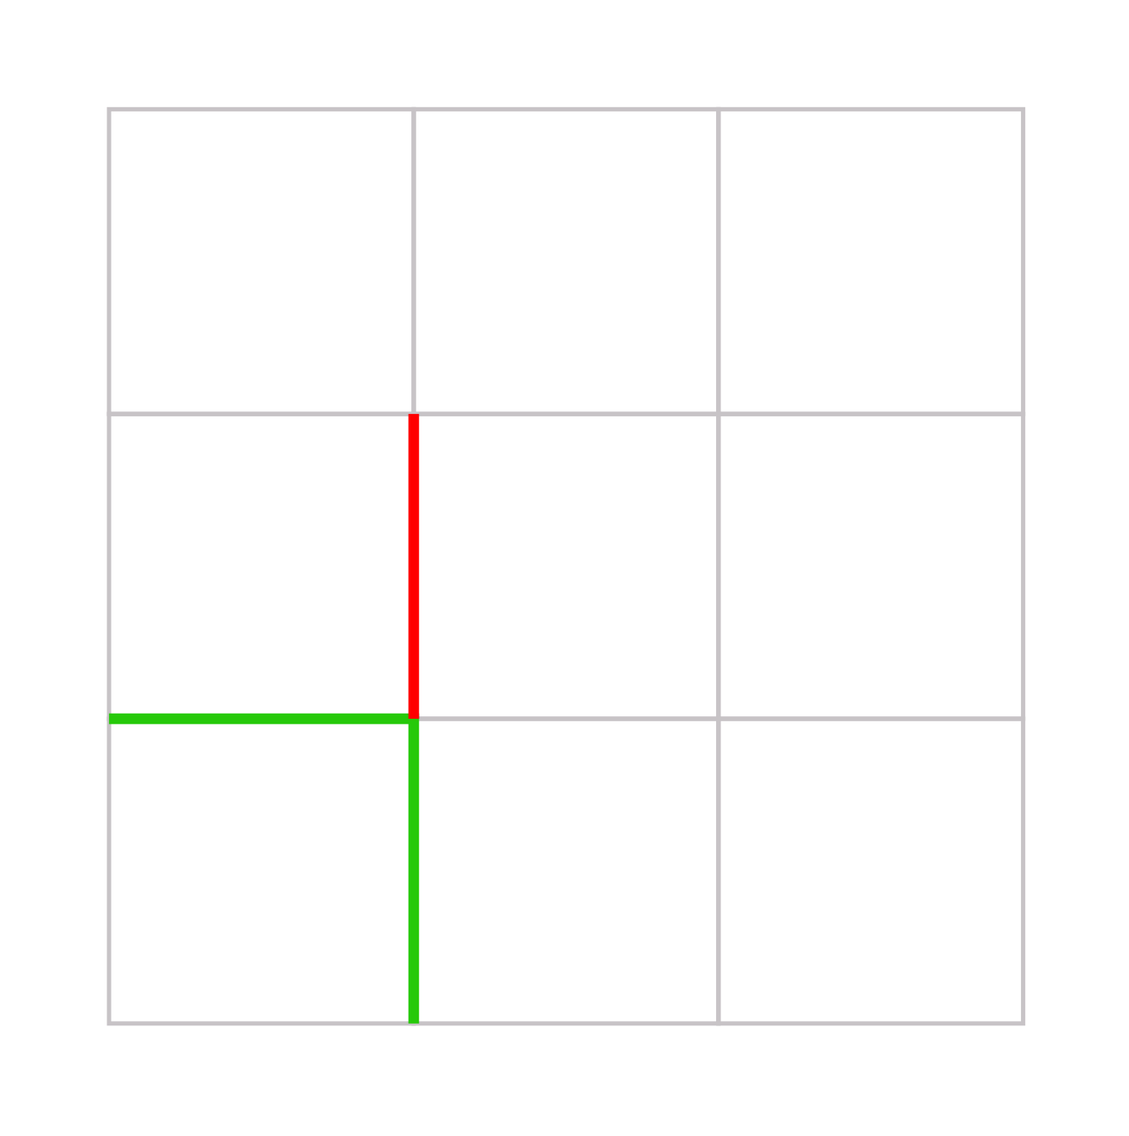
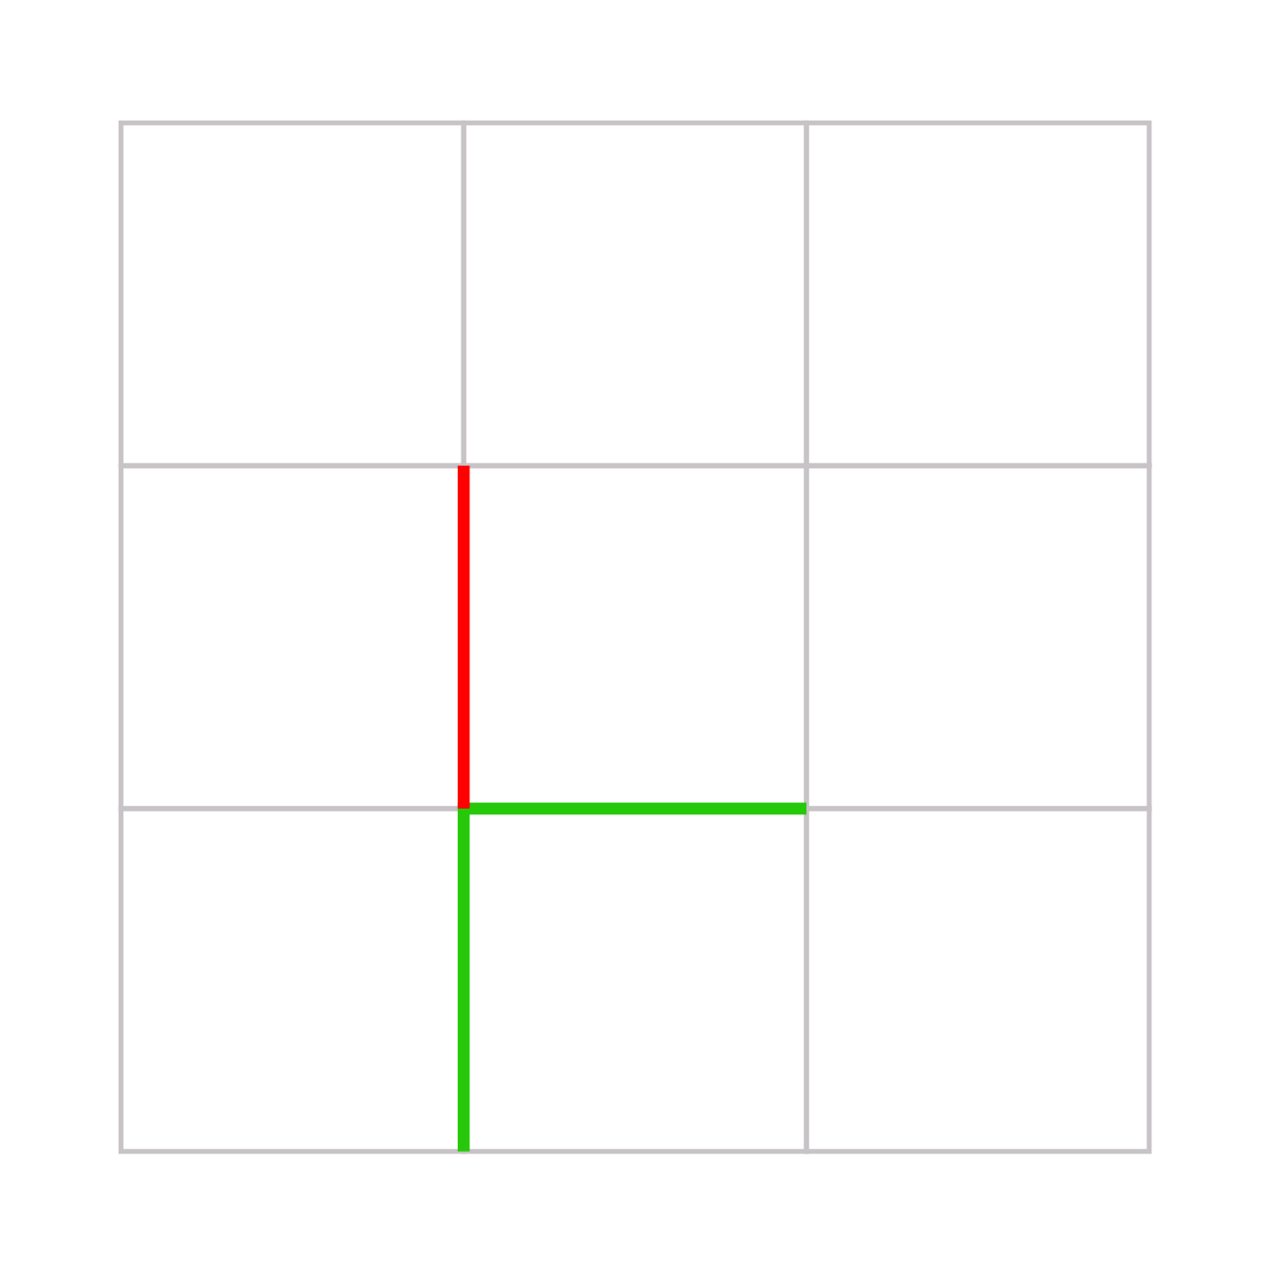
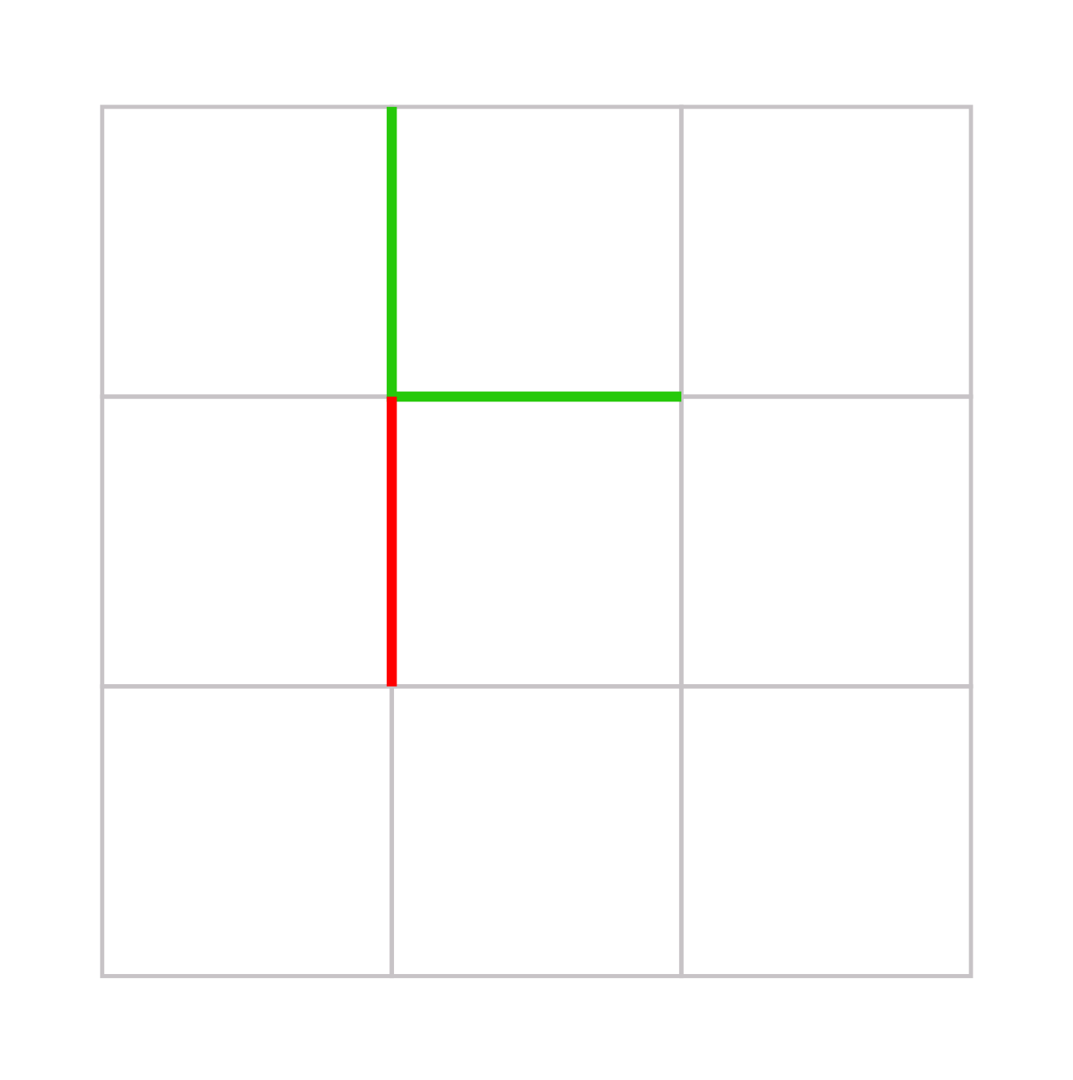
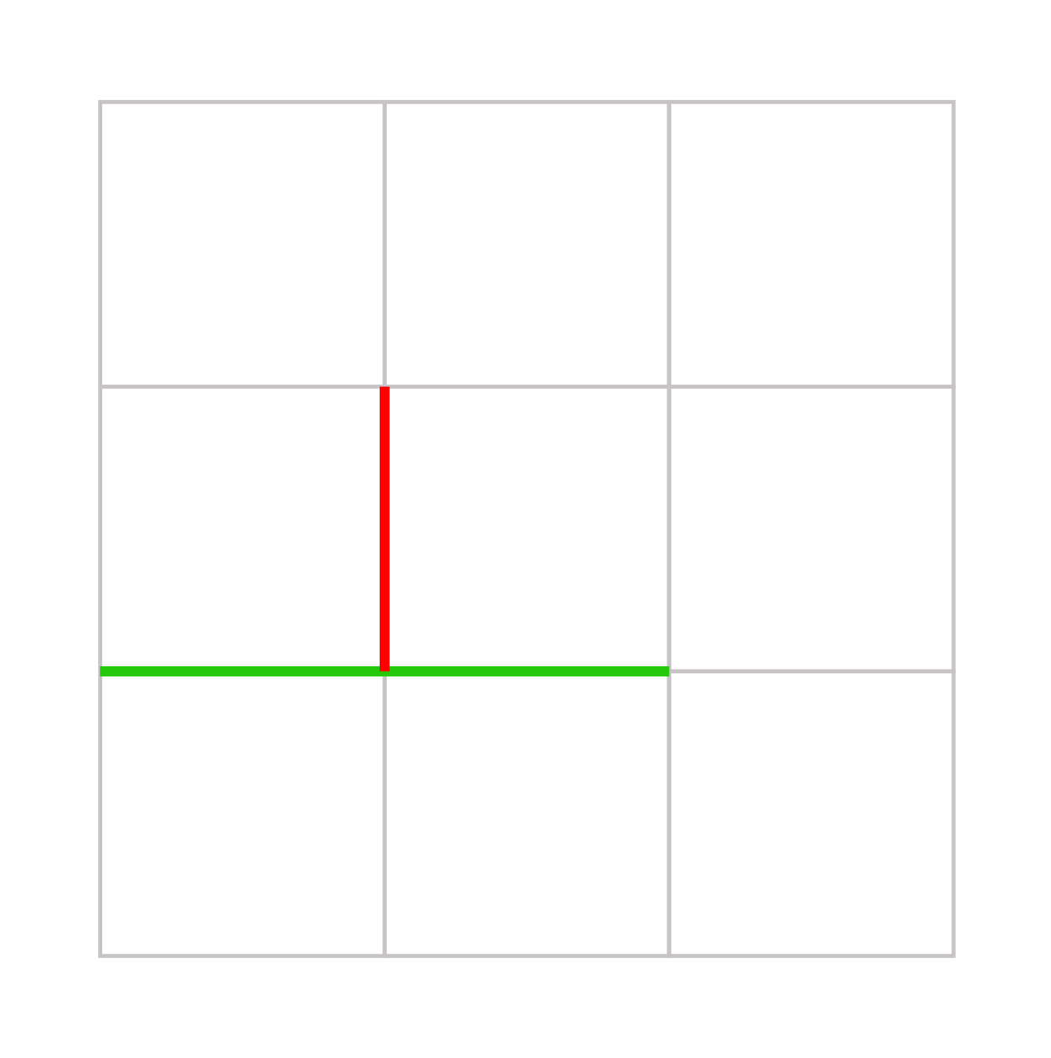
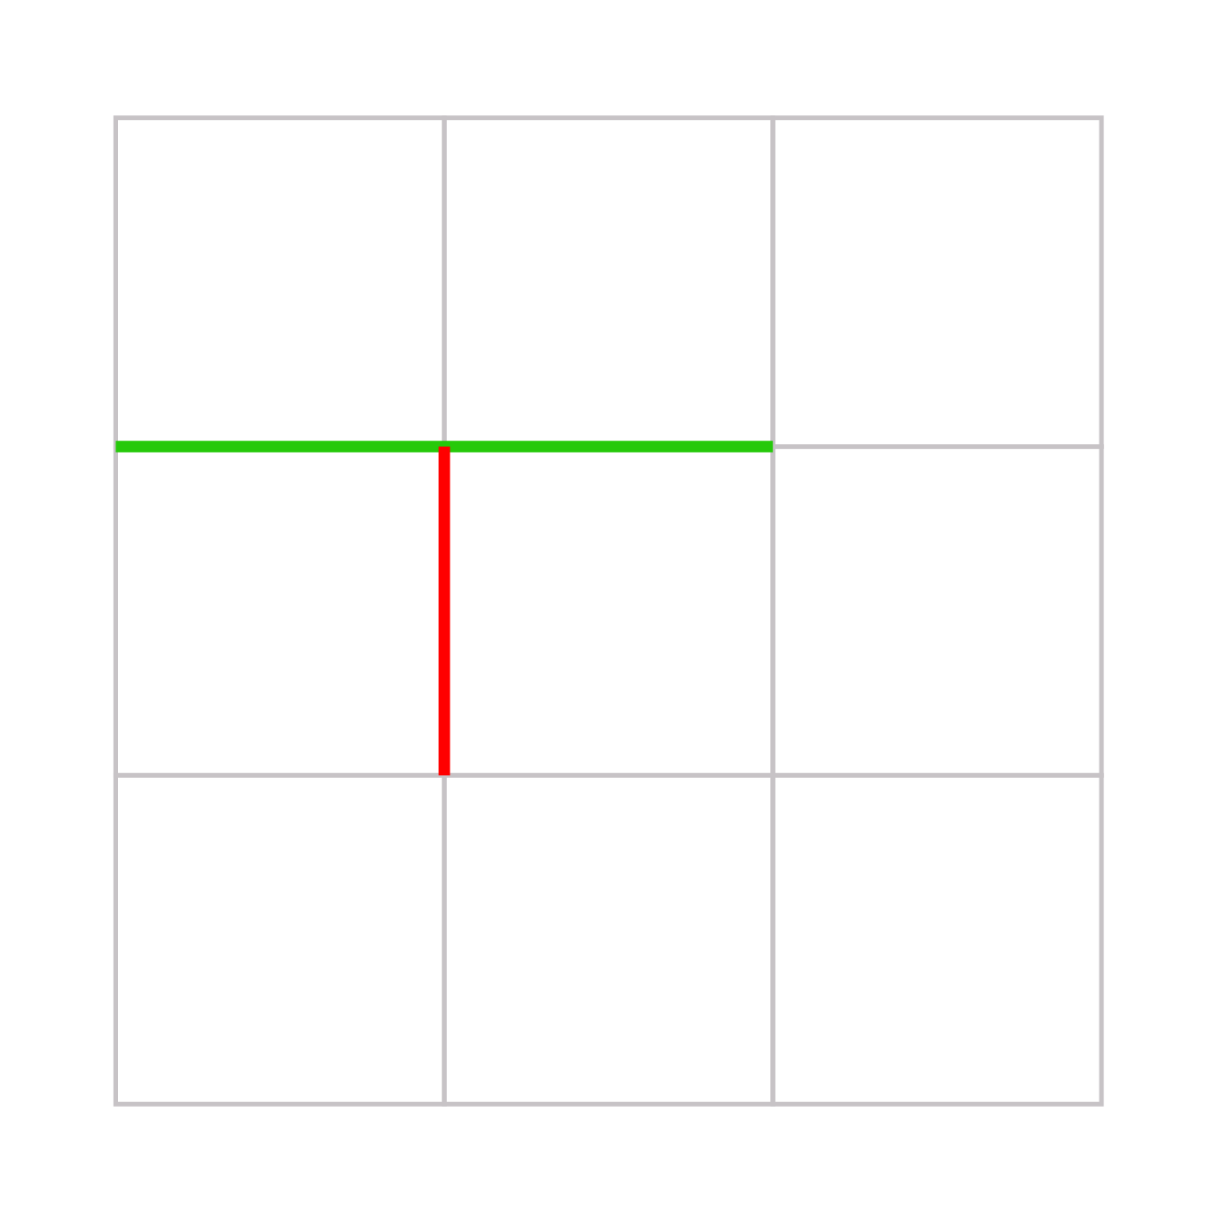
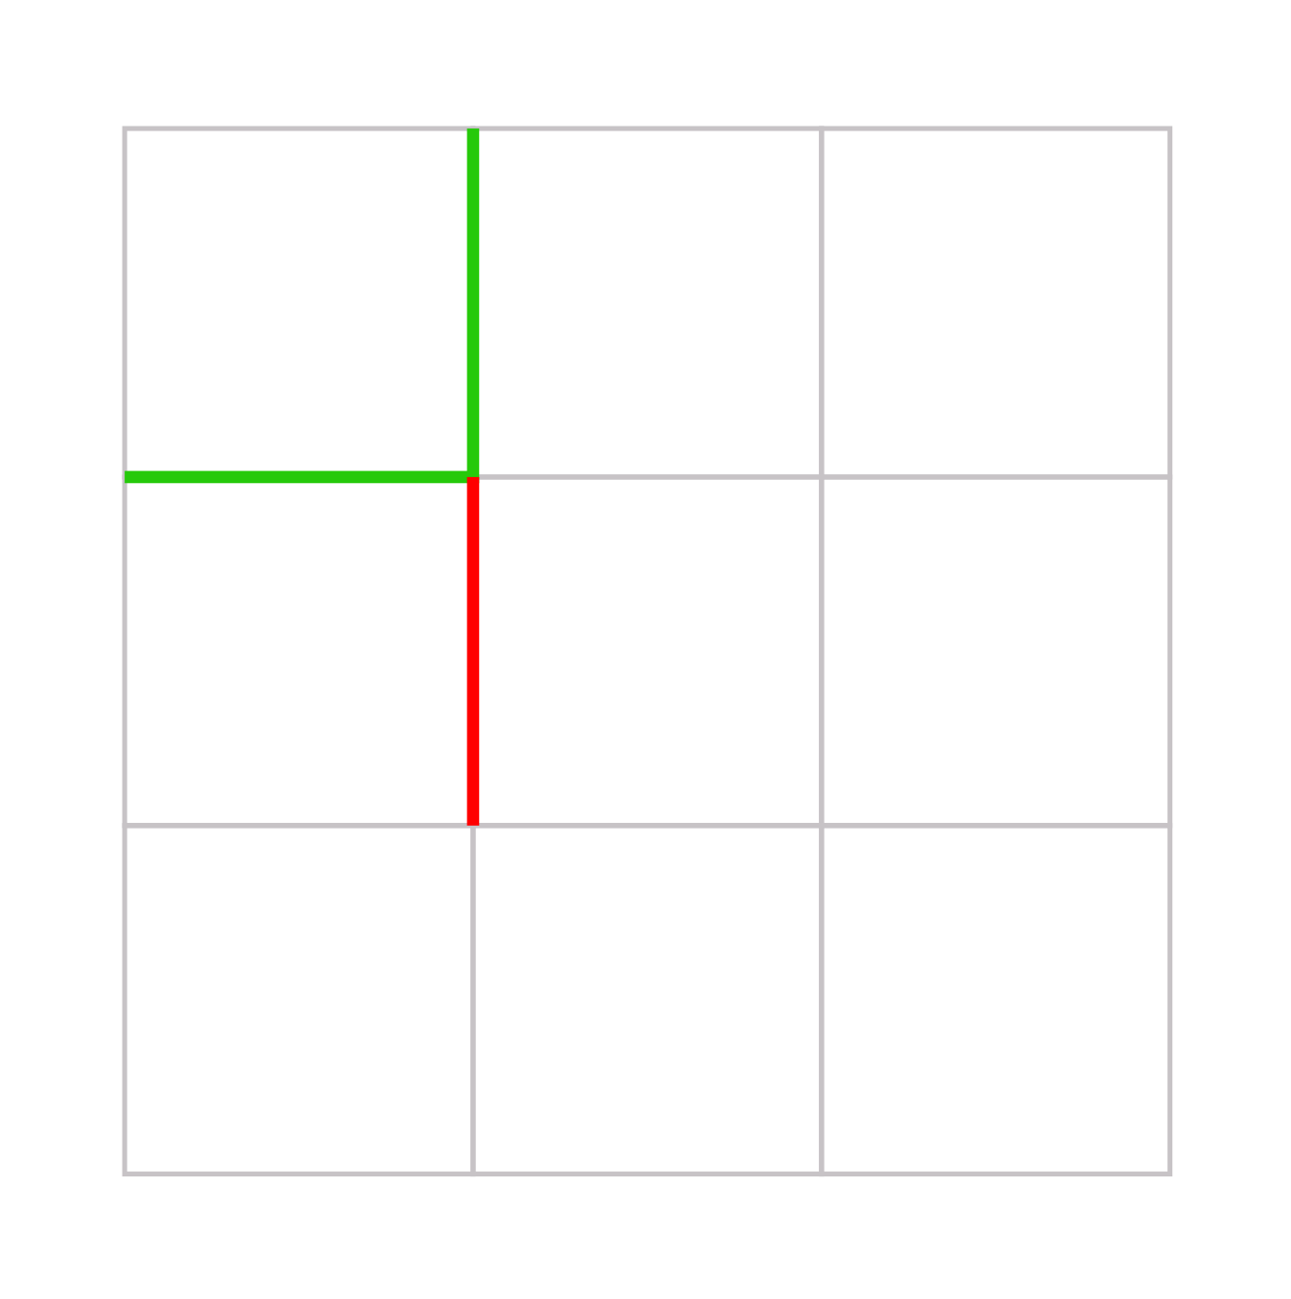
Morphological Edge Suppression
Search for all patterns that do not pass through current edge
Notes:
Then we follow the same procedure for the patterns that do not pass through the current edge,
and again score them.

Slide 28
Morphological Edge Suppression
Check which one has higher score (intensity)
Suppress edge if a pattern that do not pass through current edge wins
VS
Patterns that pass through current edge
Patterns that do not pass through current edge
Notes:
Finally we compare the highest scored pattern of the two previous sets.
If the one that wins is from the set of patterns that do not pass through the current edge,
we suppress it.

Slide 29

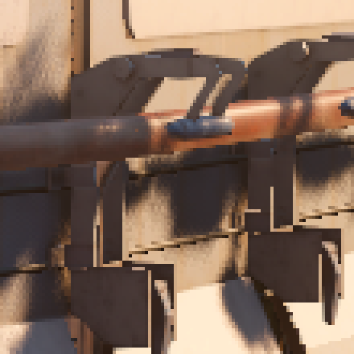
Local Contrast Edge Suppression
Close up #1
Close up #2
Notes:
So, this is the result of our previous approach to this problem…

Slide 30
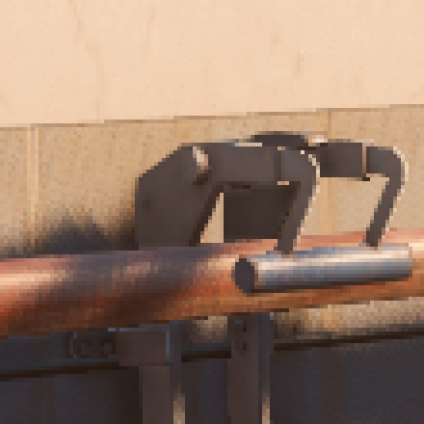

Morphological Edge Suppression
Close up #1
Close up #2
Notes:
…and this is the result of the morphological edge suppression.
[back and forth]

Slide 31
Morphological Edge Suppression
float pattern1 = 0.0;
pattern1 = max(pattern1, v[0] + v[1] + v[2] - (h[0] + h[1] + h[3] + h[4])); // t1 + t2
pattern1 = max(pattern1, k1 * (h[0] + v[1] + h[3] - (v[0] + h[1] + v[2] + h[4]))); // abs(t3 + t4)
pattern1 = max(pattern1, k1 * (h[1] + v[1] + h[4] - (v[0] + h[0] + v[2] + h[3]))); // abs(t3 + t4)
pattern1 = max(pattern1, h[0] + v[1] + h[4] - (v[0] + h[1] + h[3] + v[2] + v[4] + vv)); // abs(t3 - t4)
pattern1 = max(pattern1, h[3] + v[1] + h[1] - (h[0] + v[0] + v[2] + h[4] + v[4] + vv)); // abs(t3 - t4)
pattern1 = max(pattern1, h[0] + v[1] + v[2] - (v[0] + h[1] + h[3] + h[4] + vv)); // t3 + t8
pattern1 = max(pattern1, h[1] + v[1] + v[2] - (h[0] + v[0] + h[3] + h[4] + v[4])); // -t3 + t8
pattern1 = max(pattern1, h[3] + v[1] + v[0] - (h[0] + h[1] + v[2] + h[4] + vv)); // t4 + t7
pattern1 = max(pattern1, h[4] + v[1] + v[0] - (h[0] + h[1] + v[2] + h[3] + v[4])); // -t4 + t7
float pattern2 = 0.0;
pattern2 = max(pattern2, h[0] + h[1] - (v[0] + v[1])); // min(t1, t2)
pattern2 = max(pattern2, h[3] + h[4] - (v[1] + v[2])); // min(t1, t2)
pattern2 = max(pattern2, k2 * (h[0] + v[0] - (h[1] + v[1]))); // abs(t3) + t5
pattern2 = max(pattern2, k2 * (h[1] + v[0] - (h[0] + v[1]))); // abs(t3) + t5
pattern2 = max(pattern2, k2 * (h[3] + v[2] - (h[4] + v[1]))); // abs(t4) + t6
pattern2 = max(pattern2, k2 * (h[4] + v[2] - (h[3] + v[1]))); // abs(t4) + t6
return 2.0 * threshold < pattern1 && pattern2 - pattern1 < v[1];
float t1 = v[0] - h[0] - h[1];
float t2 = v[2] - h[3] - h[4];
float t3 = h[0] - h[1];
float t4 = h[3] - h[4];
float t5 = v[0] - v[1];
float t6 = v[2] - v[1];
float t7 = v[0] + t1;
float t8 = v[2] + t2;
float t9 = v[2] + t5;
float pattern1 = max3(t1 + t2 + v[1], k1 * (abs(t3 + t4) - t9), max3(t3 + t8 - vv, t4 + t7 - vv,
max3(-t4 + t7, -t3 + t8, abs(t3 - t4) - vv) - v[4]) - t9);
float pattern2 = max(mad(-2.0, v[1], -min(t1, t2)), mad(k2, max(abs(t3) + t5, abs(t4) + t6), -v[1]));
return max(2.0 * threshold, pattern2) < pattern1;
Naïve Implementation
Factorized Implementation
Notes:
This can be quite expensive given the many patterns to search for.
So, we factorized the patterns calculations into smaller pieces so that they can be reused in multiple patterns.

Slide 32
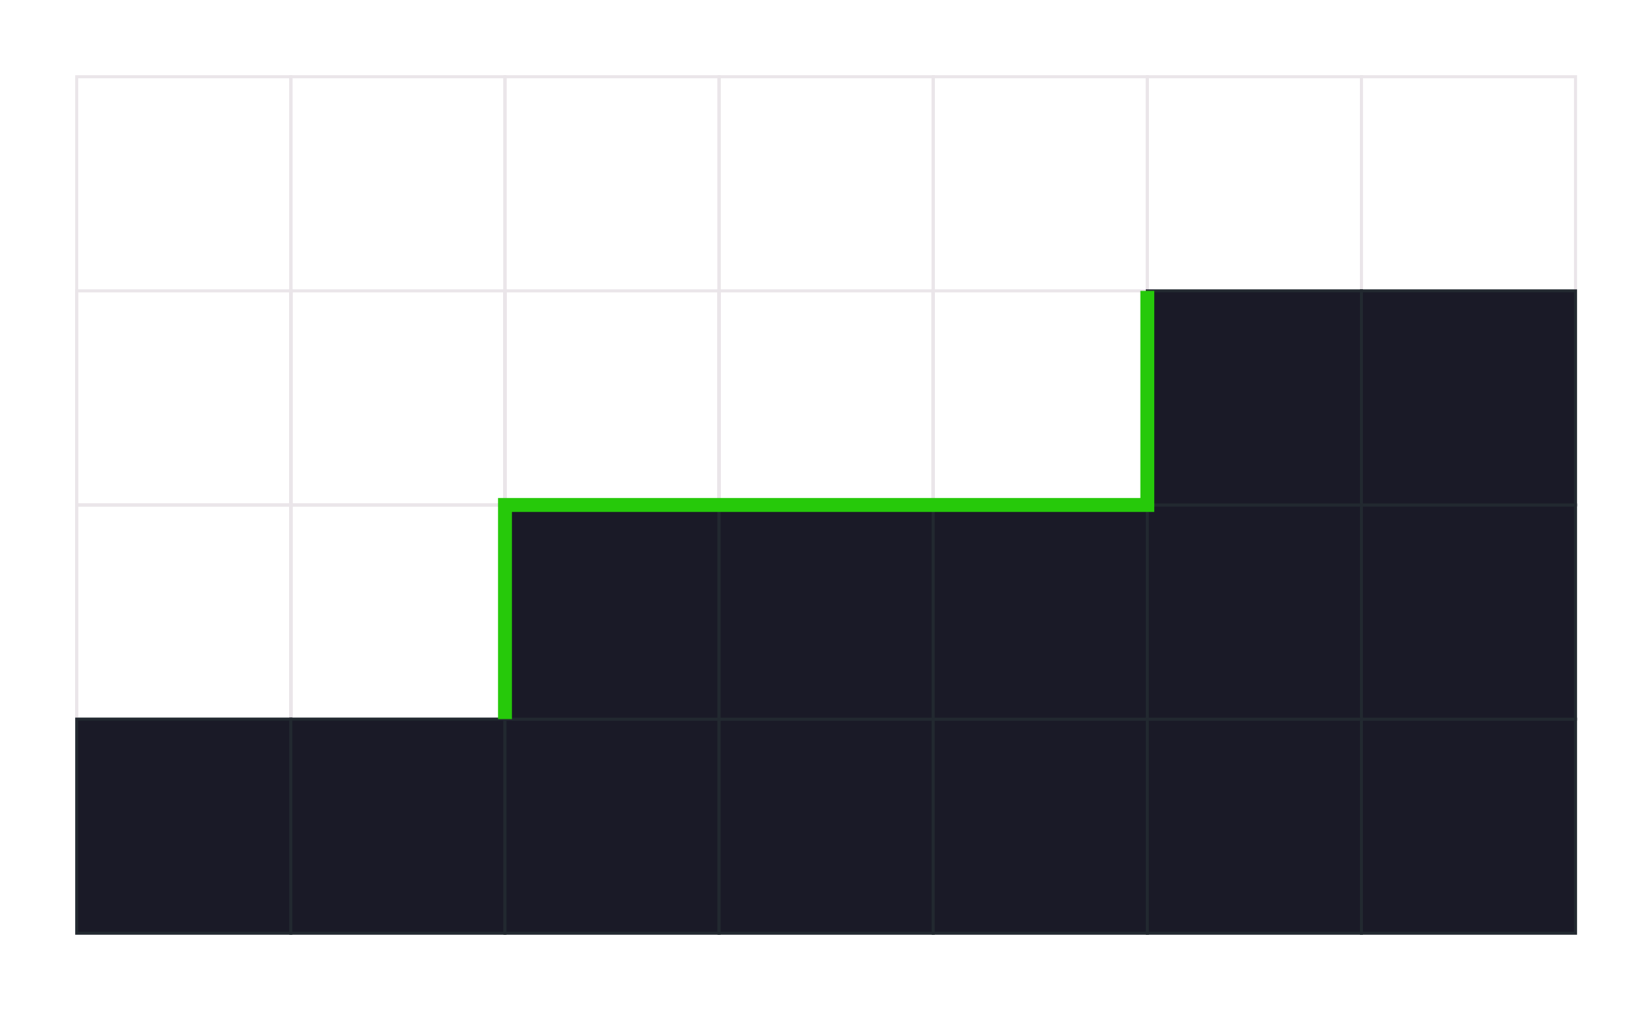
Silhouette Line Detection
Texture details sometimes confused with morphological patterns
Extend the pattern recognition
Make sure it is a silhouette line
Without silhouette line detection

Slide 33
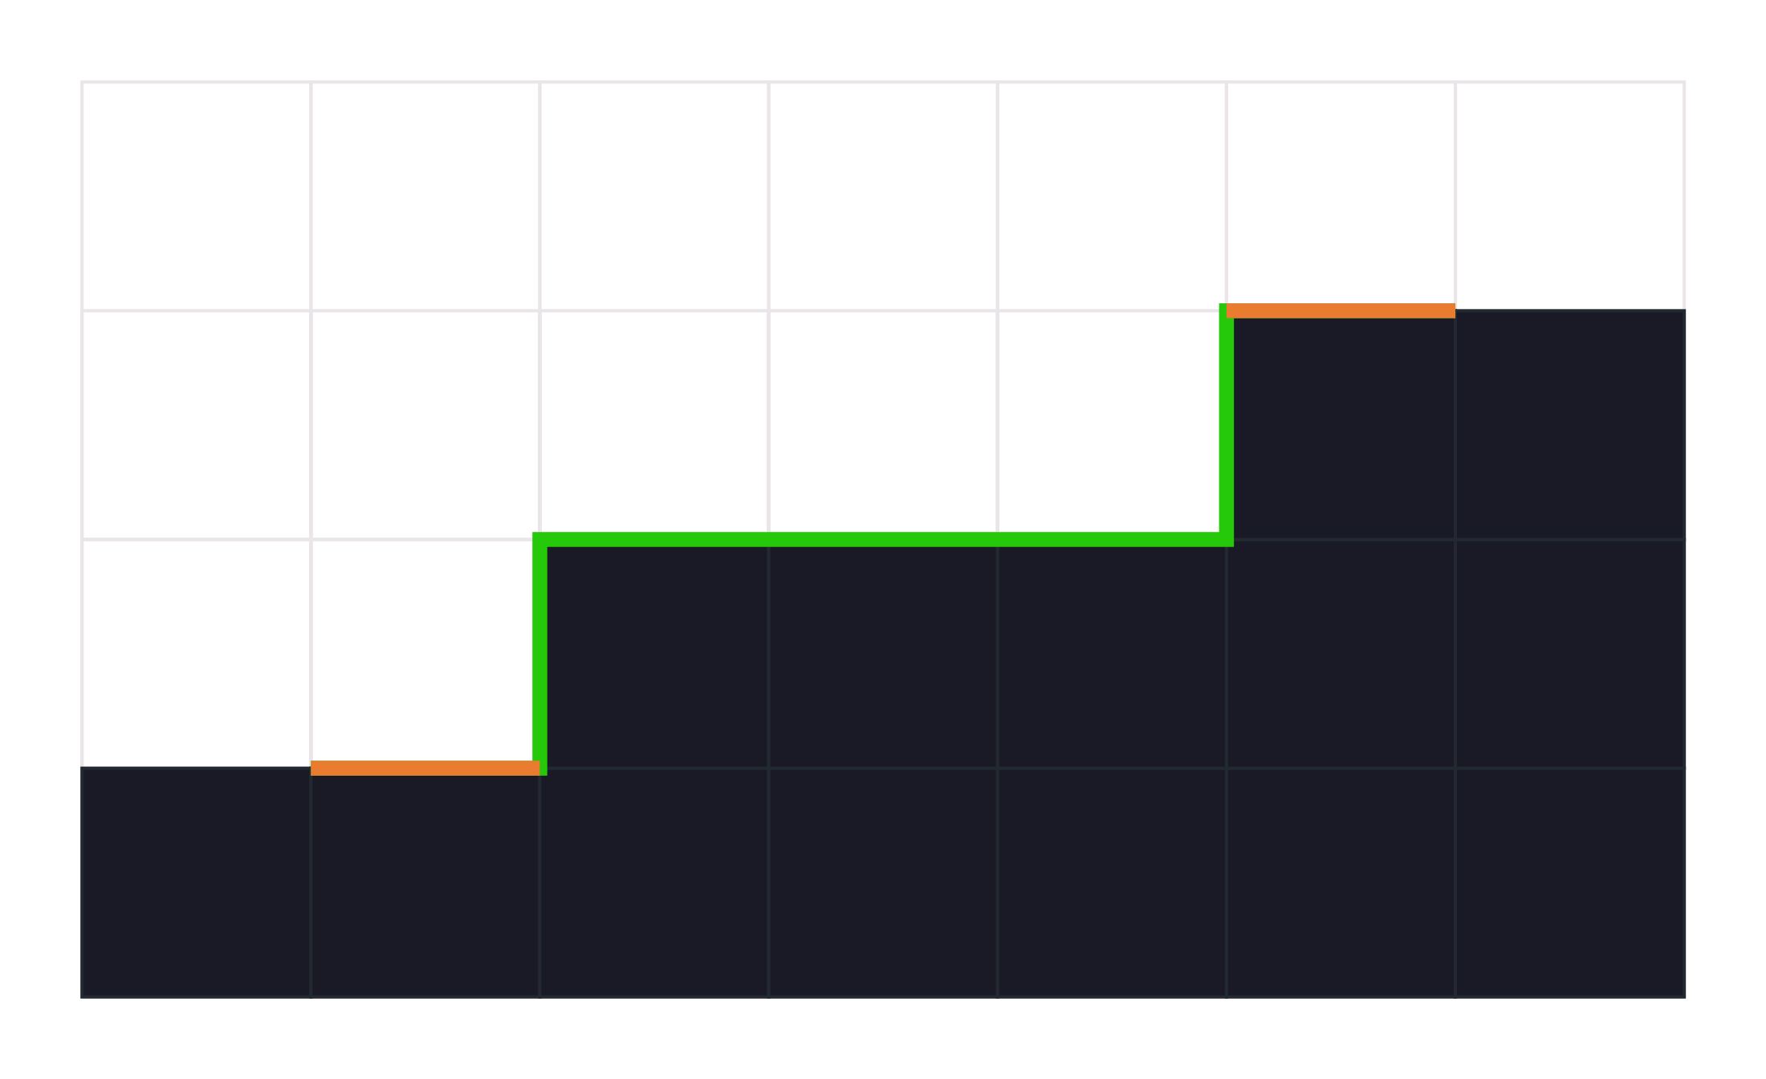
Silhouette Line Detection
Texture details sometimes confused with morphological patterns
Extend the pattern recognition
Make sure it is a silhouette line
Less filtered pixels
Sharper results
With silhouette line detection
Notes:
Texture details can be sometimes confused with morphological patterns.
In order to prevent this, we extended the pattern recognition,
to make sure we only deal with silhouette lines.
This translates to less filtered pixels, and sharper results.

Slide 34
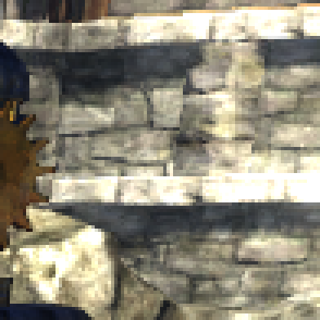
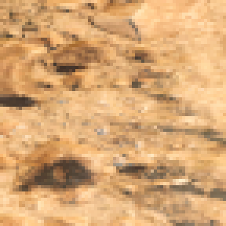
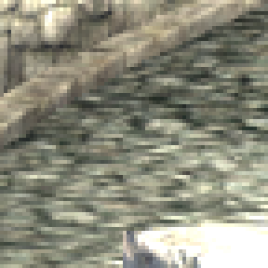
Silhouette Line Detection
Without silhouette line detection
Notes:
Here we have some examples without silhouette line detection…

Slide 35


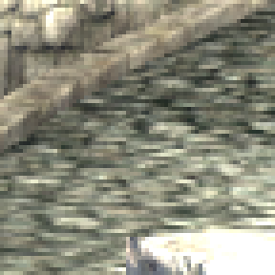
Silhouette Line Detection
With silhouette line detection
Notes:
…and here with it.

Slide 36
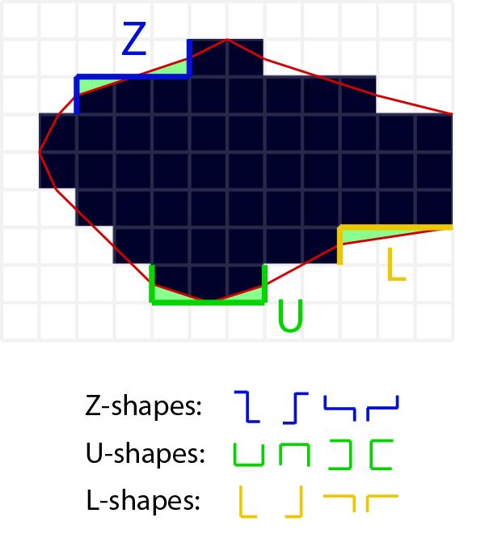
U-Pattern Smoothing
Three type of basic patterns
Small U-Patterns are temporally unstable
We want to soften or get rid of them
We are using a LUT
We can tweak to taste
Notes:
From the three basic types of morphological patterns,
the u-patterns can be specially problematic given their lack of temporal stability.
They can suddenly appear and disappear,
which is specially true for the smaller ones.

Slide 37
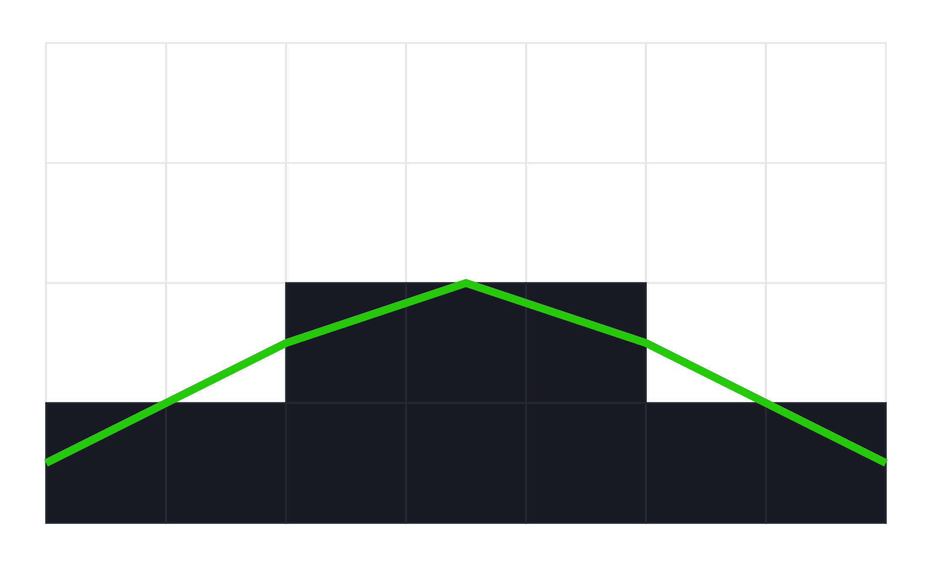
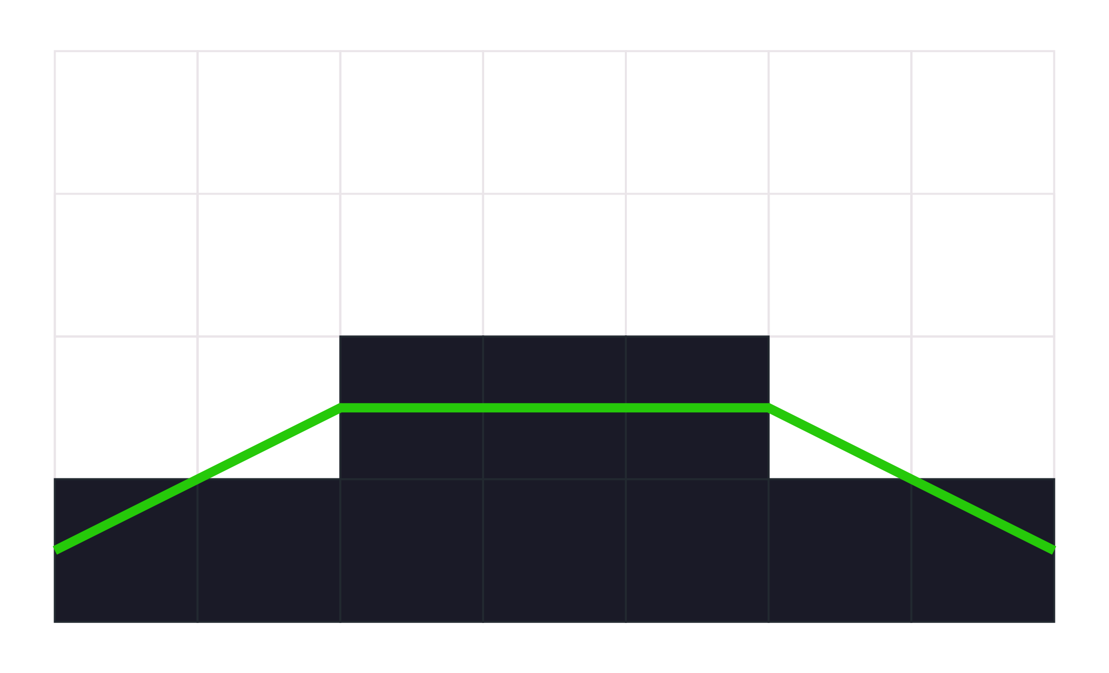
U-Pattern Smoothing
Notes:
The first thing that comes to the mind to reduce these problems is to use a flat line for the revectorization,
as can be seen on the right,
instead of the original triangle on the left.

Slide 38
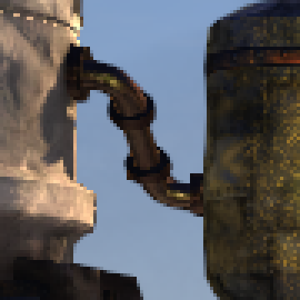
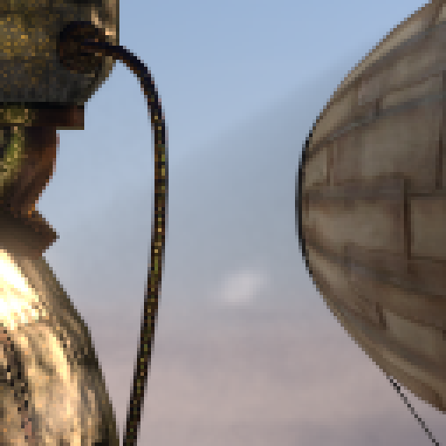
U-Pattern Smoothing
Short U-Patterns
Longer U-Patterns
Notes:
Here we have an image with the original triangle…

Slide 39
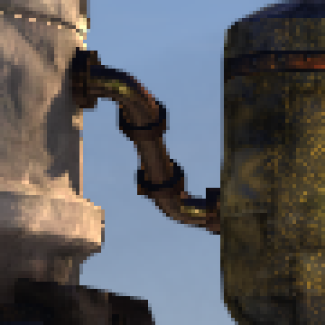

U-Pattern Smoothing
Short U-Patterns
Longer U-Patterns
Notes:
and here with the flat-line revectorization.
Unfortunately, it can generate unnatural silhouettes on curved objects,
as can be seen on the right.

Slide 40
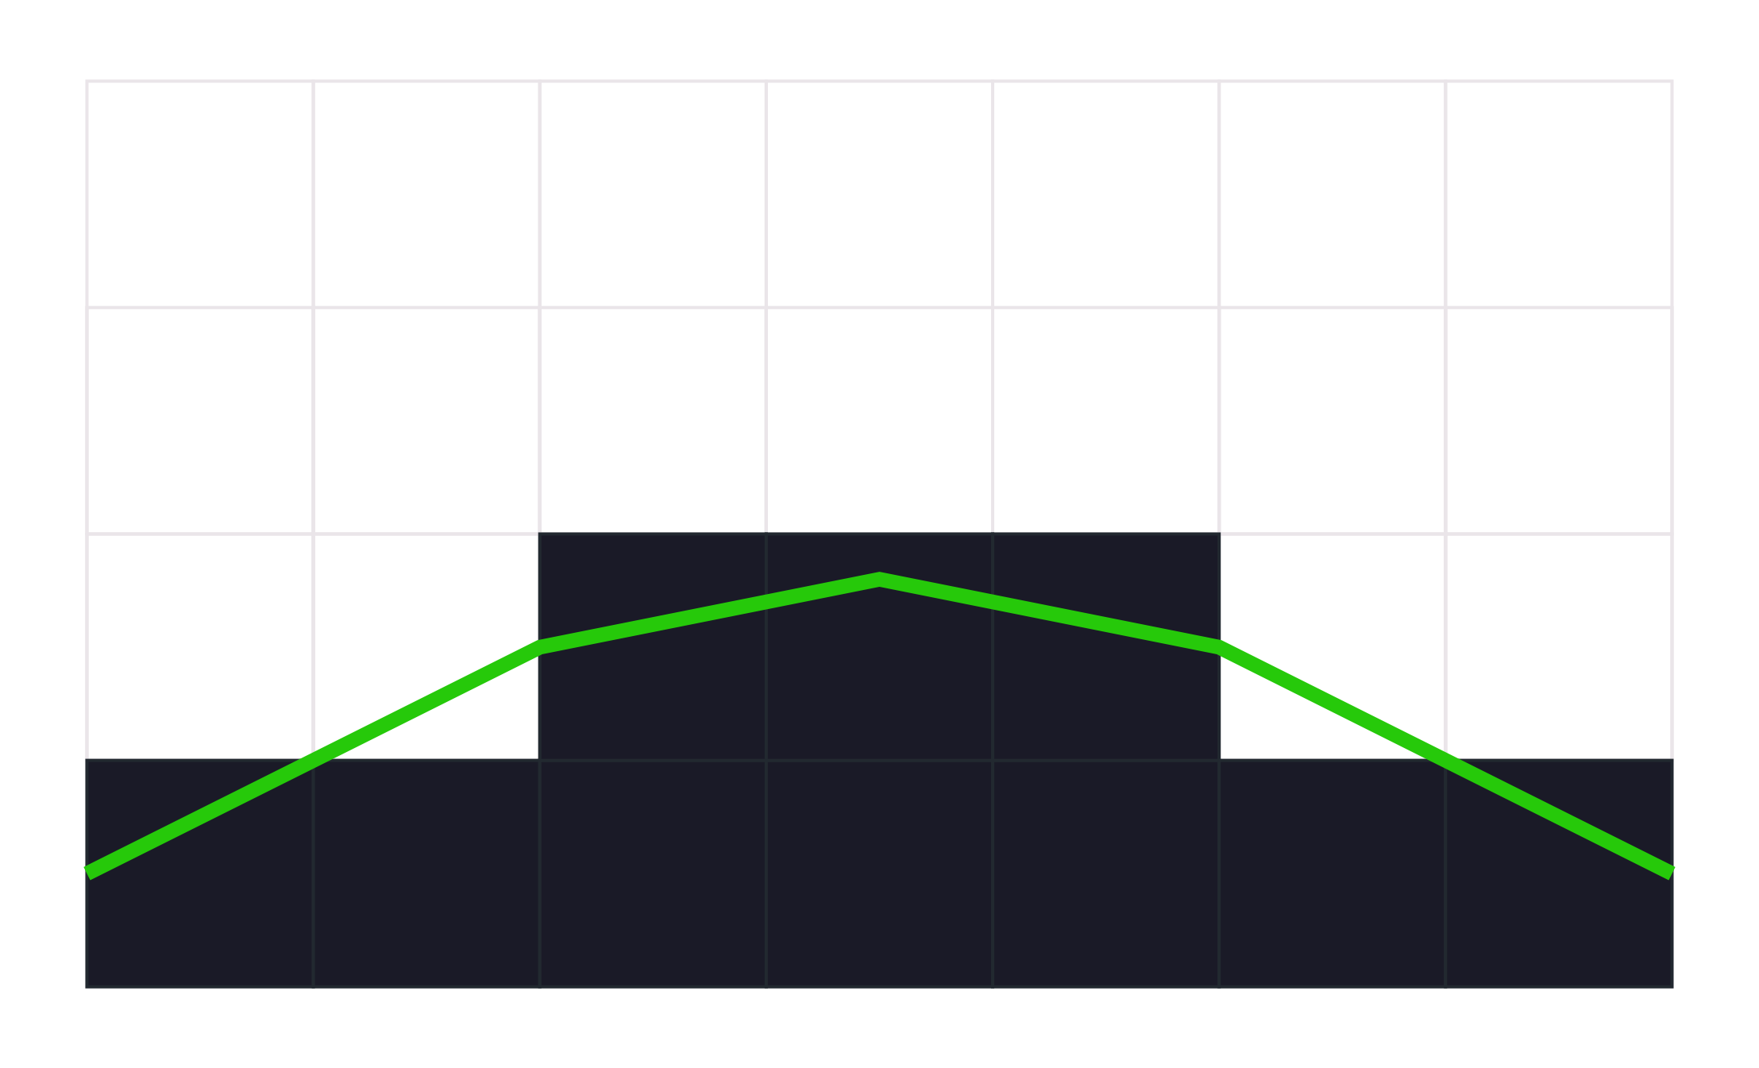


U-Pattern Smoothing
Short U-Patterns
Longer U-Patterns
Notes:
Doing something in-between allows to better preserve the shapes while still doing stronger blending than the triangle revectorization.

Slide 41
Morphological: Performance
Notes:
So, now we are going to dive into some of the performance improvements.

Slide 42
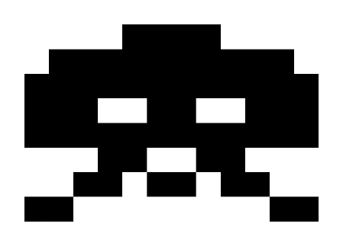
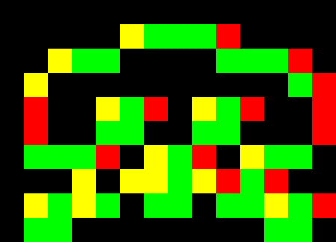
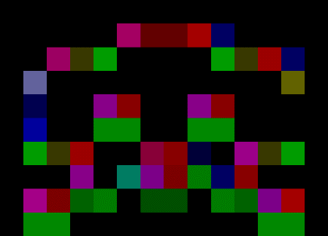

SMAA Morphological Multi Pass Approach
Writes Stencil
Uses Stencil
Original Image
1st Pass
Edge Calculation
2nd Pass
Pattern Search
3rd Pass
Antialiasing
Notes:
For this, I’ve to first do a recap of how the original SMAA morphological component worked out.
It had three passes.
In the first pass, we perform edge detection, which also writes a stencil mask.
In the second one, we search for lines and do pattern recognition, using this stencil mask.
And then in the third one, we antialias the image.

Slide 43
Reducing to a Single Pass with Compute
Tried to merge them to a single compute pass
Each pass outputting to LDS (shared storage per working group)
Can’t use straight tiles as we need neighborhood information
Overlapping/repeated calculations on tile edges
Performance savings were nullified by:
The not-so-fast LDS
Repeated calculations
So, we tried a different approach to compute
Notes:
Something that we first tried was to attempt to merge all these passes together into a single compute shader,
outputting each pass into the LDS.
For this we needed to divide the screen in tiles with overlapping borders as we need neighborhood information in each pass.
These borders duplicated calculations, and the not-so-fast LDS ended killing all the performance savings.
So, we tried an approach to compute different than the pixel shader way we used so far.

Slide 44

Pixel Shader Performance Inefficiencies
Stenciling an edge detection texture is inefficient
PS always scheduled in 2x2 quads
Partial quads can fill a wave w/few active threads
Edge Detection Output
Notes:
So, for improving performance,
we can first analyze the inefficiencies of our current pixel shader version.
Stenciling the edge detection texture is not as fine grained as we would like to,
so we typically end up with inefficiencies.

Slide 45

Stencil Culling Inefficiencies
Quad
Pixel
Pixel shader runs in quads
For derivative support
Stencil pass for antialiasing where we have edges
Yellow or green
Pixel shader waves are packed from raster generated quads
8x8 Screen Tile
Notes:
This happens because the pixel shader runs in 2 by 2 pixel quads.
Here the stencil is enabled where we have colored pixels.
The pixel shader waves are packed from raster generated quads…

Slide 46

Stencil Culling Inefficiencies
A quad can be culled only if all its 4 samples are rejected
All pixels in purple are packed in a PS wave but do nothing
Wastes efficiency
8x8 Screen Tile
Notes:
…and a quad can be culled only if all its 4 pixels are rejected.
So this means that all pixels in purple are packed in a pixel shader wave but do nothing,
which wastes efficiency.

Slide 47

Deferred Queues
This problem was solved by James Stanard’s MiniEngine FXAA, in the context of branching
https://github.com/Microsoft/DirectX-Graphics-Samples/blob/master/MiniEngine/Core/Shaders/FXAAPass1CS.hlsli
https://github.com/Microsoft/DirectX-Graphics-Samples/blob/master/MiniEngine/Core/Shaders/FXAAPass2CS.hlsli
Detected edges are appended to an append/consume buffer (about 2500 edges on a typical scene)
An indirect dispatch is executed to consume this buffer
This allows for all threads to do actual work
8x8 Screen Tile
64x1 Compute Shader Indirect Dispatch
Notes:
This problem was solved by James Stanard for FXAA in the context of branching.
The detected edges are added to an append/consume buffer, which typically contains between 2 and 3 thousand edges.
Then, an indirect dispatch is executed to consume this buffer.
This allows for all threads to do actual work.

Slide 48
Deferred Queues
Avoids reading the fullscreen stencil buffer
Hi-stencil not always optimal due to scattered edge distribution in some cases
Bad
Good
Edge Detection Output
Notes:
This also avoids reading the fullscreen stencil buffer,
given that that hierarchical stencil doesn't map well to the edge distribution that we observe in typical images.

Slide 49
Deferred Queues
We adapted SMAA to use a similar approach
Significantly improved the performance
Also has application for temporal
More on this later on
Notes:
So, we adapted SMAA to use a similar approach, which significantly improved the performance.
This also opens the door for more optimizations for our temporal approaches, as we will see later on.

Slide 50

Repeated Pattern Searches
Both red and orange pixels will search for the same pattern
Same pattern search can in theory antialias both pixels
Notes:
One inefficiency that we still have is that we repeat calculations for both sides of a given pattern.
So, here for example we see that both the red and orange pixels search for the same pattern,
so we would ideally like to share these search.

Slide 51


How SMAA Dealt with This Problem with PS
Up to 4 lines can pass through a pixel
Solution: pixels share edges, don’t repeat calculations!
Notes:
The way this was solved for the original SMAA is by searching only top/left edges,
and then sharing the pattern using an intermediate buffer.

Slide 52
How SMAA Dealt with This Problem with PS
Split Pattern Search and Antialiasing
Original Image
1st Pass
Edge Calculation
2nd Pass
Pattern Search
3rd Pass
Antialiasing
Notes:
That’s why we had to use three passes in the original pipeline.

Slide 53
How SMAA Solves This Problem with CS
Modern Era: we can now scatter values by using RW textures
Pattern search for the orange pixel and antialias both orange and red pixels
Each pixel searches top or left boundaries only (the one with higher contrast)
Notes:
But now, we can actually check only for top/left edges, and then write all the related pixels.
So here the orange one could write the antialiased results for himself, and also for the red one.

Slide 54

How SMAA Solves This Problem with CS
Problem: race conditions!
Both orange pixels and the own red could write into the red position
Each frame a different one can win (flickers)
Do I write to the left?
Do I write to the top?
Notes:
The problem is that we can find race conditions.
Both orange pixels and the own red could write the final antialiased pixel into the red position.

Slide 55

How SMAA Solves This Problem with CS
First step: serialize execution
Vertical edges then horizontal
I win!
Notes:
So, the first step to solve this is to serialize the execution,
so we first perform vertical edges, then the horizontal ones.

Slide 56

How SMAA Solves This Problem with CS
Problem: we can have race conditions within a direction
Red and blue and write to the red position
Remember: both look to the edge in their left
Second step: get edges to agree during edge detection
Checking neighbor decision
I’ve more contrast, I win!
Notes:
But we face a new problem now.
The red and blue pixels here can still write to the red position within a direction.
So, the solution for this, was to make sure that edges agree about which one is going to process a given pixel.
So, to recap, this allowed to avoid the last pass of the pixel shader version,
and also improved upon MiniEngine FXAA by processing patterns only once.

Slide 57
Using the LDS
Also using the same approach as James Stanard’s MiniEngine FXAA
Output R8 lumas in previous pass
Preload them into LDS using Gather4
Fast access to all neighbors
Useful for the morphological edge suppression
Saved 0.14ms on PS4@1080p

Slide 58
Performance Recap
PS4@1080p
Deferred queues + Dual edge blending
0.16ms
LDS:
0.14ms
Brought performance back from (note that varies per scene):
0.774ms to 0.475ms
Faster than FXAA
Notes:
All the compute optimizations that we performed saved 0.3ms on the PS4 at 1080p,
which made of SMAA (without diagonal processing) a slightly faster option than FXAA.

Slide 59




One of Many Optimizations
Input Image
Edges Texture
Edge detection stores edges to the left and top
Sometimes we need left and top pixels at the same time
Single fetch (RG) ☺
Sometimes we need right and top (or other permutations)
Two fetches (one for R, other for G) ☹

Slide 60



Bilinear Fetch and Decode!
Fetch with bilinear and a 0.25 offset
Possible values when edge is enabled:
Red: (0.75 * x + 0.25 * 1) $→$ 0.25 or 1.0
Green: (0.75 * 1 + 0.25 * x) $→$ 0.75 or 1.0
We can unpack both in three instructions:
Red: abs(mad(5.0, sample.r, -5.0 * 0.75))
Green: round(sample.g)
edge.r
sample.r

Slide 61
Temporal
Notes:
So, now let’s get into the temporal part.
I’ll first do a recap of the common toolset that one need to use to implement temporal solutions.
And then, we will cover the improvements that we have made.

Slide 62


Temporal Antialiasing Toolset: Jittering
Regular Grid
SSAA 2x
Notes:
Here we have a regular grid on the left and a 2x rotated grid on the right.

Slide 63


Temporal Antialiasing Toolset: Jittering
Current Frame
Previous Frame
Current Frame
SMAA T2x
Notes:
So the first thing one have to do, is to apply a temporal jitter,
which means to apply a different subpixel offset to the camera view projection matrix for each frame,
as we can see in this slide.
So odd frames will render in the orange position, and even frames will in the blue one.

Slide 64

Temporal Antialiasing Toolset: Temporal Reprojection
For motion:
Reproject current red pixel to previous frame position using motion vectors
Notes:
Ok, so this works great for static images,
but for moving ones, we need to reproject to the previous frame position using per-pixel motion vectors, as shown here.

Slide 65


Temporal Antialiasing Toolset: Disocclusion and Velocity Weighting
Disocclusion: pixels in the new frame not present in previous one
Solution: don’t blend if velocities are too different
Don’t work for pixels without velocities (alpha blended)
Without Velocity Weighting
With Velocity Weighting
[Sousa2011][Jimenez2012]
Notes:
Then the next problem that we find are disocclusions,
which are pixels that exist in the new frame but didn’t in the previous one.
A solution for this problem is velocity weighting,
which essentially rejects the previous frame information if the velocities are too different.
This obviously breaks down for pixels that doesn’t have correct velocities like alpha blended objects.
This is the solution that the original SMAA T2x used to avoid ghosting.

Slide 66


Temporal Antialiasing Toolset: Disocclusion and Color Weighting
Color information can also be used for disocclusions
Together with velocity weighting
Can’t compare current and previous frame
Different jitters: would often reject even on static images
Solution: Compare Frame N with Frame N-2 [Drobot2014]
Mitigates ghosting on objects without velocities (alpha blended)
Frame N
Frame N-1
Frame N-2
[Sousa2011][Jimenez2012]
Notes:
Other solution that can applied on top of this is the color weighting or color motion flow,
which was introduced by Drobot in 2014.
But we can’t just compare current and previous frame,
given that the color will be probably different due to the subpixel offset.
So, the solution taken here is to compare the current color with the color 2 frames ago,
which have matching offsets.

Slide 67

Temporal Antialiasing Toolset: Exponential History / Exponential Moving Average
SMAA T2x and similar techniques use two frames
$c_{aa}=0.5c_{i}+0.5$ $c_{i−1}$
Current Frame
AA
Antialiased Image
Previous Frame
Notes:
The original SMAA T2x uses the current and previous frames,
and conditionally blends them depending on disocclusion conditions.

Slide 68

Temporal Antialiasing Toolset: Exponential History / Exponential Moving Average
We can leverage an exponential accumulation buffer:
$h_{i+1}=αc_{i}+(1−α$) $h_{i−1}$
Similar to moving average of multiple frames [Karis2004]
Increase effective subsample count
Feedback loop
Blend Factor
Next exponential history sample
Current frame sample
Previous exponential history sample
Antialiased Image
Current Frame
AA
History Buffer
Notes:
Other approaches use an exponential accumulation buffer,
which contains a feedback loop as we can see in this figure.
So, we blend the current frame with the result for the temporal antialiasing in the previous pass.
Using this it is possible to accumulate more than two frames,
which increases the effective sample count.

Slide 69
Temporal Antialiasing Toolset: Exponential History / Exponential Moving Average
Current Frame
AA
Antialiased Image
SMAA T2x
(two-frames temporal)
Previous Frame
Antialiased Image
Exponential History
Current Frame
AA
History Buffer
Notes:
So, here we have both compared for an easier reference.

Slide 70


Temporal Antialiasing Toolset: Neighborhood Clamp
Exponential accumulation buffer techniques typically use neighborhood clamping for disocclusion [Lottes2011]
On its basic form:
$p=max⁡(min\left(p,n_{max}\right),n_{min})$
$n_{min}$ and $n_{max}$ and are min and max colors in the 3x3 dashed neighborhood
Notes:
The next tool in the temporal antialiasing toolset is the neighborhood clamp,
which is typically used in techniques using the exponential accumulation buffer.
There are many flavors to it, but on its basic form we just pick the minimum and maximum color in the current frame neighborhood,
marked with the dashed line in the image here,
and then clamp the reprojected value to those.
In general, this effectively reduces the ghosting to a single pixel.

Slide 71




Temporal Antialiasing Toolset: Neighborhood Clamp Flickering Problem
Min Color
Max Color
Min Color
Max Color
Current Frame (Jitter#1)
Previous Frame (Jitter#2)
Clamp and Resolve (Jitter#1)
Clamp and Resolve (Jitter#2)
Equal ☺
Notes:
When using this clamp together with temporal jitters, it might lead to flickering.
Here we can see a case where clamping gives the same antialiased image for the both frames that we are considering,
as the neighborhood contains the same information for both frames,
so the clamp works as expected.

Slide 72


Temporal Antialiasing Toolset: Neighborhood Clamp Flickering Problem
Min Color
Max Color
Min Color
Max Color
Current Frame (Jitter#1)
Previous Frame (Jitter#2)
Clamp and Resolve (Jitter#1)
Clamp and Resolve (Jitter#2)
Different $→$ Flickers ☹
Notes:
In this case, given that the geometry is very small, it just disappeared in the second frame,
and the neighborhood range of colors changed between frames.
This made the output to differ, which creates flickering artifacts on static images.

Slide 73




Temporal Antialiasing Toolset: Nearest Velocity
Exponential history is smooth and antialiased
Fresh frame velocities are aliased
Will introduce aliasing when reprojecting
Solution: take front most neighborhood velocity [Karis2014]
Velocity Buffer
Antialiasing Output
Pixels that lost AA
Notes:
The final tool I’ll cover is the nearest velocity technique, or velocity dilation, which was first introduced by Karis in 2014.
The problem that this solves is that the exponential history buffer contains smooth and antialiased pixels,
but the fresh frame velocities are aliased, which introduces aliasing when doing the reprojection.
The proposed solution for this was to sample five velocities in the pattern shown here and then keep the front most one.
For example, here we have the fresh velocities on the top,
the antialiased output in the middle, and the pixels that lost the AA marked in green on bottom.
This technique would make these green pixels to use the red velocities on the neighbors in the image on the top,
allowing them to preserve the antialiasing.

Slide 74
Temporal Antialiasing Toolset: More!
Shaped neighborhood YCoCg clipping [Karis2014]
Soft neighborhood clamping [Drobot2014]
Higher order resampling [Drobot2014]
Variance clipping [Salvi2016]
...
Notes:
There are many more, but I covered the ones that are relevant for our own technique.

Slide 75
Previous Work
Notes:
So now, I’ll cover how some of the previous techniques used this toolset.

Slide 76


SMAA 1TX [Sousa2013]
SMAA morphological for edges
No subpixel jitter
Simplified neighborhood clamping
Using diagonals only
Spatial-contrast exponential history
Blend with history more strongly on high contrast areas
Helps to keep texture details in motion
Spatial-Contrast Exponential History
Not used for clamping
Simplified neighborhood clamping
Notes:
SMAA 1TX uses SMAA morphological for edges, it doesn’t perform any jitter,
but still uses an exponential accumulation buffer to stabilize images in motion,
combined with simplified neighborhood clamping.
The key component of this technique was the usage of spatial-contrast to modulate the blending with the accumulation buffer,
So, it essentially blends more strongly for more differing pixels,
which helps to keep texture details in motion.

Slide 77

Unreal Engine 4 AA [Karis2014]
8x subpixel jittering
Halton(2,3)
Exponential history
Advanced neighborhood clamping
Shaped neighborhood YCoCg clipping
Tighter clamp (reduced ghosting)
Nearest velocity
Distance to clamp
Notes:
Unreal Engine 4 solution used subpixel jittering,
an exponential history accumulation buffer,
advanced neighborhood clamping,
nearest velocity and then a technique called distance to clamp
which helps to reduce the flickering on static images, which is caused by the neighborhood clamp as shown before.

Slide 78

HRAA [Drobot2014]
For temporal, hybrid approach between SMAA T2x and Unreal Engine 4 AA
CRAA or SMAA Morphological for edges
2x subpixel jittering
Using flipquads for 4x effective rate
Disocclusions:
Velocity weighting
Introduces color flow (weighting)
Exponential history after the temporal 2x resolve
Advanced neighborhood clamping
Soft clamp, only accepts colors near min and max
Higher order resampling for sharper results
Notes:
HRAA uses MSAA based subpixel reconstruction, with 2x temporal jittering with flipquads accounting for an effective rate of 4x,
uses velocity and color weighting, and
an advanced neighborhood clamping that only accepts colors that add meaningful information to the current color.
For keeping sharp details in motion it uses higher order resampling.

Slide 79
HRAA [Drobot2014]
Similar to SMAA 1TX or UE4 AA
Frame N
Temporal Resolve
Temporal Filter
Antialiased Image
Frame N-1
Similar to SMAA T2x +
Color Weighting
Frame N-2
Exponential History Buffer
Notes:
In a sense, it can be seen as an hybrid approach between SMAA T2x and Unreal Engine 4 AA,
in the sense that it only uses two jitter values, but it also uses an exponential accumulation buffer.
One of the most key contributions made, is that the exponential accumulation reprojection,
called temporal filter in this diagram,
happens after temporally resolving the jitter.
This way, the jitter is eliminated before performing the exponential accumulation in the temporal filter step,
so the neighborhood clamp will never introduce flickering problems.

Slide 80
Key Takeaway: Temporal Filter is Decoupled from AA
Using an exponential history is a process that can be decoupled from supersampling with subpixel jitters
Will be called temporal filter from now on
It has the effect to temporally filter (or blur) an image
We can think that as a side effect it can blur or average temporal subpixel jittering
Even when not jittering, objects in motion naturally fall in different subsample positions each frame
Objects in motion will have AA even if no jitter is used
Notes:
They key takeaway here is that using an exponential history is a process that can be decoupled from supersampling with subpixel jitters.
And again, we will call the exponential history usage as temporal filtering from now on.
Even when no jittering is used, objects in motion naturally fall in different subsample positions each frame,
so you will still get an antialiasing effect in motion even if no jitter is used.

Slide 81
Filmic SMAA T2x
SMAA T2x
Filmic SMAA T2x
Subsamples: 2x
Edges: Morphological
Temporal filter: No
Subsamples: 2x (Optional Contrast-Aware Quincunx for ~4x)
Edges: Morphological
Temporal filter: Yes
Ghosting on objects without velocities
Stable in static images
Reduced ghosting
Tight performance budget
Sharp
Stable in static images
Notes:
So now we finished the previous work and we will start with our own technique.
The key improvements that Filmic SMAA T2x brings to the table with respect to T2x, are:
The usage of a temporal filter for additional stability in motion,
reduced ghosting artifacts,
preserving sharpness and,
to do that under a tight performance budget,
For achieving this, it will use some of the previously mentioned toolset, but then we also show how we improved part of it.
Filmic T2x, just like HRAA or T2x, is stable in static images.
Actually it is close in spirit to HRAA temporal component, and was product of concurrent work two years ago.

Slide 82
Temporal Antialiasing Improvements
Separate temporal supersampling and temporal filtering
Temporal filtering sharpness
Temporal spatial contrast Tracking
FPS-aware temporal filtering
Extending neighborhood clamping with depth testing
Improved temporal supersampling resampling
Improved temporal Quincunx
Supersampling derivatives
Improved color weighting
Low-profile velocity buffers
Faster closest velocity
Temporal upsampling
Notes:
So, these are the improvements that we will cover in this talk,
The grayed out ones will still be available in the online slides.
So, let’s start with the first one.

Slide 83
Separate Temporal Supersampling and Temporal Filtering
[Drobot2014]
Single Pass
Frame N
Temporal Resolve
Temporal Filter
Antialiased Image
Frame N-1
Frame N-2
Exponential History Buffer
Notes:
We use a similar approach to Drobot 2014 shown here,
but a key difference is that we split the temporal resolve and filtering passes into…

Slide 84
Separate Temporal Supersampling and Temporal Filtering
Filmic SMAA T2x
Two Passes
Frame N
Temporal Resolve
Temporal Filter
Antialiased Image
Frame N-1
Frame N-2
Exponential History Buffer
Notes:
…two steps.
This has the main advantage of allowing for the neighborhood clamp
in the temporal filter to have 2x antialiased neighbors.
This means that we can keep values from the history buffer more often
given that the chances of subpixel features disappearing are reduced by half.

Slide 85



Temporal Antialiasing Toolset: Neighborhood Clamp
Min Color
Max Color
Min Color
Max Color
Current Frame (Frame#1)
Previous Frame (Frame#2)
Clamp and Resolve (Frame#1)
Clamp and Resolve (Frame#2)
Notes:
Just to put it with an example.
In motion, we can have a flickering subpixel feature like this, where it is present in some frames, but not in others.
When the subpixel feature disappears, the history value is lost due to the clamp.
In our approach, the chances of subpixel features disappearing like here are reduced by half
given that the 2x antialiased values will widen this minimum and maximum color to a valid range in many cases,
instead of having a flat white color as we see in this figure.
In the end, this will translate to additional temporal stability.

Slide 86


Notes:
So here we have comparison move between doing the supersampling and temporal filtering together on the left,
and separated on the right.
On the crop in the top left image, you see how the grid looks in a static image.
So, note how it becomes more unstable and darker when doing both steps together, on the left.

Slide 87


Temporal Filtering Sharpness Temporal Contrast
SMAA 1TX [Sousa2013] lowers $α$ in low spatial contrast areas
Inspired by this, we instead lower $α$ in low temporal contrast areas
No filtering is performed on temporal edges below a threshold
Won’t cause subpixel jitter/flicker because input already stabilized before temporal filtering
Resets the accumulation buffer when current color is similar (prevents numerical diffusion)
Similar in spirit to [Drobot2014] acceptance metric
Temporal edges added to a deferred queue
Similar to morphological
$h_{i+1}=αc_{i}+(1−α$) $h_{i−1}$
[Sousa2013] Spatial-Contrast Exponential History
Notes:
Previous SMAA 1TX lowers the blending factor with the accumulation buffer in low spatial contrast areas.
Thinking about the accumulation buffer usage as a temporal filter,
it is easier to realize that what it might be more desirable to only perform the filtering on pixels with temporal contrast,
which can be seen as a temporal bilateral filter.
For achieving this, edges below a temporal contrast threshold are essentially ignored.
Then, for the others we lower the effect depending on the temporal contrast.
For performance, we also add the pixels that need temporal filtering into a deferred queue,
which we call temporal edges.

Slide 88
Temporal Filtering Sharpness Bicubic Resampling
Bicubic filtering reduces numerical diffusion error on the exponential history
Catmull-Rom yields the best results
Optimized version uses 9 samples
Thanks to Bart Wronski for sharing the idea
We only apply Catmull-Rom on temporal edges
When consuming the deferred queue
Still expensive
Higher order resampling is an alternative option [Drobot2014]
Notes:
The usage of exponential history comes at the cost of numerical diffusion, which translates to image blur.
We found that bicubic filtering substantially helps to preserve the sharpness.
In particular, we used Catmull-Rom, which has one of the most strong sharpening effects,
but unfortunately even the most optimized version uses 9 samples.
We only use the bicubic filtering on temporal edges, but it is still an expensive solution.

Slide 89
Temporal Filtering Sharpness Bicubic Resampling
Bilinear access
Optimized Catmull-Rom uses 9 bilinear samples to process the 4x4 area
http://vec3.ca/bicubic-filtering-in-fewer-taps/
http://http.developer.nvidia.com/GPUGems2/gpugems2_chapter20.html
(-1,-1)
(0,0)
(2,2)
Notes:
So, here we have the standard 9 sample bicubic implementation.

Slide 90
Temporal Filtering Sharpness Bicubic Resampling
Ignoring the 4 corners yields very similar results
Reduces from 9 to 5 taps
(-1,-1)
(0,0)
(2,2)
Notes:
And here is what we ended using.
So, we essentially removed the corners of the filter…

Slide 91

Temporal Filtering Sharpness Bicubic Resampling
Small numerical error
Possible applications in other areas
9 Samples
5 Samples
Error
Notes:
…and as we can see here it has a quite small numerical error.
The difference is particularly negligible in motion.
We believe that this optimization might be useful in other contexts as well.

Slide 92
Shader Code
float3 SMAAFilterHistory(SMAATexture2D colorTex, float2 texcoord, float4 rtMetrics)
{
float2 position = rtMetrics.zw * texcoord;
float2 centerPosition = floor(position - 0.5) + 0.5;
float2 f = position - centerPosition;
float2 f2 = f * f;
float2 f3 = f * f2;
float c = SMAA_FILMIC_REPROJECTION_SHARPNESS / 100.0;
float2 w0 = -c * f3 + 2.0 * c * f2 - c * f;
float2 w1 = (2.0 - c) * f3 - (3.0 - c) * f2 + 1.0;
float2 w2 = -(2.0 - c) * f3 + (3.0 - 2.0 * c) * f2 + c * f;
float2 w3 = c * f3 - c * f2;
float2 w12 = w1 + w2;
float2 tc12 = rtMetrics.xy * (centerPosition + w2 / w12);
float3 centerColor = SMAASample(colorTex, float2(tc12.x, tc12.y)).rgb;
float2 tc0 = rtMetrics.xy * (centerPosition - 1.0);
float2 tc3 = rtMetrics.xy * (centerPosition + 2.0);
float4 color = float4(SMAASample(colorTex, float2(tc12.x, tc0.y )).rgb, 1.0) * (w12.x * w0.y ) +
float4(SMAASample(colorTex, float2(tc0.x, tc12.y)).rgb, 1.0) * (w0.x * w12.y) +
float4(centerColor, 1.0) * (w12.x * w12.y) +
float4(SMAASample(colorTex, float2(tc3.x, tc12.y)).rgb, 1.0) * (w3.x * w12.y) +
float4(SMAASample(colorTex, float2(tc12.x, tc3.y )).rgb, 1.0) * (w12.x * w3.y );
return color.rgb * rcp(color.a);
}

Slide 93

Notes:
So, here we have a comparison movie between bilinear and bicubic.
When you see the red line it will bilinear, and the green one means bicubic.
Pay attention to the floor stones in the center of the image.
[Note that the red/green bar on the bottom is hidden by the progress bar if not seen in fullscreen mode]

Slide 94

Temporal Spatial Contrast Tracking
We track temporal changes on spatial contrast
In addition to temporal contrast changes (or temporal edges)
Changes in spatial contrast means flickering is taking place
We can prevent flickering pixels from appearing
Increase convergence time if a pixel is flickering
Similar in spirit to [Karis2014] distance to clamp. Quick recap:
Lerp $α$ towards 1 if history color $h_{i−1}$ is close to neighborhood min or max
If it was clamped in previous frame
Introduced to prevent subsample jittering flickering
$h_{i+1}=αc_{i}+(1−α$) $h_{i−1}$
// Calculate the spatial contrast weight using the neighborhood min/max:
spatialContrast.weight = SMAAContrastWeight(SMAA_FILMIC_WEIGHTING_SPATIAL_MIN,
SMAA_FILMIC_WEIGHTING_SPATIAL_MAX,
result.minLuma, result.maxLuma);
// Detect temporal changes in spatial contrast (flickering pixels):
float spatialContrastWeight = abs(currentSpatialContrast.weight –
historySpatialContrast.weight);
// Calculate the history color weight:
float convergenceTime = lerp(lerp(SMAA_FILMIC_WEIGHTING_STRENGTH_LOW,
SMAA_FILMIC_WEIGHTING_STRENGTH_HIGH,
temporalContrastWeight),
SMAA_FILMIC_WEIGHTING_STRENGTH_FLICKER, // High!
spatialContrastWeight);
float weight = SMAAFilmicStrength(framesPerSecondRcp, convergenceTime); return lerp(currentColor, historyColor, weight);
Notes:
In addition to tracking temporal contrast changes,
we also track temporal changes on spatial contrast,
which typically means that a pixel is flickering.
This allows to prevent flickering pixels from appearing by increasing the convergence time
when such a situation is detected.
The similar distance to clamp technique, first introduced in [Karis2014] also prevents flickering pixels from appearing,
which was key for avoiding flickering on static images, caused by subpixel jittering.

Slide 95
Notes:
Red means without temporal spatial contrast tracking, green with it.
[Note that the red/green bar on the bottom is hidden by the progress bar if not seen in fullscreen mode]

Slide 96
Temporal Spatial Contrast Tracking
Both distance to clamp and temporal spatial contrast tracking are powerful tools to avoid flickering
In the case of our technique, distance to clamp generated artifacts on edge gradients
Possibly because our fresh image contains edges already antialiased by the morphological component
Notes:
In our implementation, distance to clamp generated artifacts on pixels in edge gradients,
as they sometimes get “stuck” with the accumulation buffer values,
possibly due to our fresh current frame image already containing antialiased pixels (by morphological antialiasing).

Slide 97

Temporal Spatial Contrast Tracking
Distance to clamp
Temporal Spatial Contrast Tracking
Notes:
Here we have distance to clamp used with SMAA on the left, and temporal spatial contrast tracking on the right.

Slide 98

FPS-Aware Temporal Filtering
Blending factor $α$ depends on frames per second
$h_{i+1}=αc_{i}+(1−α$) $h_{i−1}$
We want to set the filter effect with respect to convergence time
Otherwise 30fps will be blurrier than 60fps
PC high-spec with unlocked fps will get better AA
https://en.wikipedia.org/wiki/Exponential_smoothing#Time_Constant
float Alpha(float framesPerSecondRcp, float convergenceTime)
{
return exp(-framesPerSecondRcp / convergenceTime);
}
Notes:
One common mistake made in exponential accumulation approaches is to use a constant blending factor,
which doesn’t warrantee the converge time.
For example, this means that 30 FPS will look blurrier tan 60 FPS,
as we don’t express the blending factor in time units,
that is what we usually want.
To do that, you have to use an exponential function to get the correct blending factor.

Slide 99
Extending Neighborhood Clamping with Depth Testing
Neighborhood clamping do not remove all ghosting
High frequency changes on the neighborhood window perform the clamp differently
Ghosting persists
Usually only seen in motion
Notes:
Unfortunately, neighborhood clamping do not remove all ghosting.
High frequency changes on the neighborhood window perform the clamp differently,
and in those cases ghosting persists.

Slide 100
Notes:
In this movie, you can see that in the weapon cannon, ghosting appears only in its bottom half,
where high frequency details exist,
but not in the other half.

Slide 101
Extending Neighborhood Clamping with Depth Testing
Performing a low pass on the neighborhood window helps
Blurring neighbors with bilinear filtering
Introduces back aliasing
[Salvi2016] proposed using variance for a tighter clamp/clip
In our technique/testbed [Salvi2016] + clipping introduced back some aliasing
Using variance or a low pass on the neighborhood reduce the min/max window
Less ghosting but potentially more aliasing
To keep maximum temporal smoothing effect, we use depth testing to detect disocclusions
Compare current and previous frame depth
Half resolution nearest depth
“Responsive AA” for alpha blended objects [Karis2014]
With depth testing and “Responsive AA” we mitigate all cases without harming the temporal filtering effect on opaque objects
neighborhood[0] = SMAASample(colorTex, mad(SMAA_RT_METRICS.xy, 0.6 * float2(-1.0, -1.0), texcoord)).rgb;
neighborhood[1] = SMAASample(colorTex, mad(SMAA_RT_METRICS.xy, 0.6 * float2(-1.0, 1.0), texcoord)).rgb;
neighborhood[2] = SMAASample(colorTex, mad(SMAA_RT_METRICS.xy, 0.6 * float2( 1.0, -1.0), texcoord)).rgb;
neighborhood[3] = SMAASample(colorTex, mad(SMAA_RT_METRICS.xy, 0.6 * float2( 1.0, 1.0), texcoord)).rgb;
Notes:
To solve this, we tried to perform a low pass filter on the neighborhood window,
but unfortunately it introduces back some aliasing.
Our solution for this comes back to the classic disocclusion detection using depth values for current and previous frame,
discarding the history buffer sample when a disocclusion happens.
[Note that if using this with non stabilized input (with jittering), a conservative depth comparison need to be performed:
comparing nearest-to-camera depth in the current and previous frame neighborhoods]

Slide 102
Notes:
In this movie you can see the results in action.
On red without depth weighting, and on green with it.
[Note that the red/green bar on the bottom is hidden by the progress bar if not seen in fullscreen mode]

Slide 103
Improved Temporal Supersampling Resampling
Filmic SMAA T2x
Separate passes
Frame N
Temporal Resolve
Temporal Filter
Antialiased Image
Frame N-1
Frame N-2
Exponential History Buffer
Notes:
If you remember this previous diagram, we need to reproject for the exponential history buffer,
and also for previous frames for the temporal resolve.
But we can’t use bicubic for all of them given that it is still expensive, even after the optimizations.
But these other reprojections are not using a feedback loop, so they don’t have numerical diffusion problems.
So perhaps a cheaper solution works over there.

Slide 104


Improved Temporal Supersampling Resampling
Temporal supersampling also resamples
Bicubic filtering nice, but overkill (no numerical diffusion on supersampling: not recursive)
Iñigo Quilez improved texture interpolation
Change fractional part of texcoord to smoothstep
http://www.iquilezles.org/www/articles/texture/texture.htm
Snaps texcoord to centers
Thanks to Xianchun Wu for the idea
$$x^{2}(3−2x)$$
Notes:
We found that using Inigo Quilez bicubic approximation,
which uses a smoothstep on the fraction part of the texcoords,
we get good enough results.

Slide 105





Improved Temporal Supersampling Resampling
Smoothstep
Smootherstep
Smootheststep
$$x^{2}(3−2x)$$
$${ x}^{3}(x\left(6x−15\right)+10)$$
$${−20x}^{7}+\text{70}x^{6}−{84x}^{5}+\text{35}x^{4}$$
Notes:
We tried different smoothsteps, and we choose the one on the right, which has the strongest S-shape,
which will obviously have the strongest sharpening effect,
given that it will snap samples more strongly to the pixel centers.
But it is expensive…

Slide 106


Improved Temporal Supersampling Resampling
Smootheststep
Fast Smootheststep
$${−20x}^{7}+\text{70}x^{6}−{84x}^{5}+\text{35}x^{4}$$
$$u=max\text{(}\text{min}\text{((}\text{x}\text{ − 0.2})\text{/}\text{(}\text{1 − 0.4})\text{,1})\text{,0})$$
$$u^{2}(3−2u)$$
Notes:
So we do instead is to approximate this using the cubic smoothstep,
but with a clamp and rescale,
which is what you can see on the right.

Slide 107


Improved Temporal Supersampling Resampling
Current Frame
Notes:
So, here we have some results.
This is the current frame…

Slide 108

Improved Temporal Supersampling Resampling
Previous Frame
Resampled with bilinear
Notes:
…and this is the resampled frame.
As you can observe it is substantially blurrier.
[back and forth]

Slide 109

Improved Temporal Supersampling Resampling
Previous Frame
Resampled with fast smootheststep
Notes:
And this is the previous frame but resampled using the approximated smootheststep.
[flip back and fort]

Slide 110


Improved Temporal Quincunx Basic Quincunx
Better subsample coverage $\sim$4x
Fast 0.5px wide resolve
Softens the texture details
Infamous in the previous gen
Not so bad at 1080p
Used for temporal AA in Crysis 2 [Sousa2011]
Flip quads a good alternative [Drobot2014]
Different stability, performance and sharpness tradeoff
We went for the less efficient but faster and sharper Quincunx
Rotated Grid 2x
Quincunx
Notes:
Quincunx is sampling scheme that yields an effective coverage near to 4x,
but only with two samples.
The drawback is that it softens the texture details,
which was infamous in the previous generation of consoles.

Slide 111



Improved Temporal Quincunx Basic Quincunx
Rotated Grid 2x
Better Subsample Coverage ☺
Softer Texture Details ☹
Notes:
Here you have a comparison of regular 2x…

Slide 112



Improved Temporal Quincunx Basic Quincunx
Quincunx
Better Subsample Coverage ☺
Softer Texture Details ☹
Notes:
…and Quincunx.
Notice the improved subpixel coverage on the first and second images,
but the softer texture details on the right.

Slide 113



Improved Temporal Quincunx Faster Quincunx
Frame 2
Quincunx definition
Orange is a single sample
We can fetch all blue with bilinear
Quincunx becomes:
Texcoord offset
Same performance as 2x
Frame 1
$0.5 ×$
$+ 0.5 ×$
Sample here to get all four subsamples
Notes:
Quincunx averages 5 samples.
However, the four pixels in blue can be efficiently sampled using bilinear filtering and a texture coordinate offset.
So the good news here, is that it has the same performance as regular 2x sampling.

Slide 114

Improved Temporal Quincunx Contrast-Aware Quincunx
Idea: lerp the texcoord offsets according to local contrast
Low contrast (texture details): 2x
High contrast (edges): Quincunx
Use Quincunx subsamples to determine contrast
Refetch with 2x offsets if low contrast
Cheap: $\sim$0.02ms on PS4@1080
Notes:
To improve upon regular quincunx, we realized that its effect can be modulated according to local contrast.
This way, we only apply it where high contrast is detected, allowing to better preserve texture details.

Slide 115
Improved Temporal Quincunx Contrast-Aware Quincunx
Rotated Grid 2x
Better Subsample Coverage ☺
Sharp Texture Details ☺
Notes:
Here we have the regular 2x sampling…

Slide 116



Improved Temporal Quincunx Contrast-Aware Quincunx
Contrast-Aware Quincunx
Better Subsample Coverage ☺
Sharp Texture Details ☺
Notes:
…and here the contrast-aware Quincunx that we just introduced.
Note that it still improves on the subsample coverage,
but is also able to keep most of the texture details.

Slide 117

Supersampling Derivatives
ddx
Derivatives calculated for 1x uniform grid
ddy
Notes:
One common error done with temporal supersampling is that the derivatives will be incorrect.
So, here we can see the correct ones for the case of 1x uniform grid…

Slide 118

Supersampling Derivatives
ddx?
For 2x derivatives between subsamples smaller
Blurrier results
Grid is rotated
What ddx/ddy to use?
ddy?
Notes:
Unfortunately, when using temporal supersampling we still use the same,
but the distances from subsamples is now smaller.
This translate to blurring.

Slide 119


Supersampling Derivatives
If we think of derivatives as filtering radius, we have a tradeoff:
Minimal overlap (blur): 0.7071
Minimal holes (aliasing): 1.0
Adjust gradients by diagonal distance:
SampleGrad(..., 0.7071 * ddx, 0.7071 * ddy)
Faster and identical results:
SampleBias(..., log2(0.7071))
Better: use texture sampler LOD bias
Thanks to Peter-Pike Sloan and Angelo Pesce for the ideas
Sharper results
Uniform Grid 1x
Rotated Grid 2x
Notes:
If we think of derivatives as a filtering radius, and we adjust gradients by diagonal distance,
as we illustrate on the bottom right,
we can trade from blur and aliasing by minimizing either the overlap or the holes.
But this can get expensive.

Slide 120
Supersampling Derivatives
Mip typically selected using this (section 3.9.11 of OpenGL spec):
float grad = max(length(ddx), length(ddy))
float mip = log2(grad);
We want to do:
float mip = log2(0.7071 * grad);
Which is equivalent to:
float mip = log2(0.7071) + log2(grad)

Slide 121

Supersampling Derivatives
Alternatively, unjitter the diffuse and normal map texture coordinates
Using the barycentric position of the subsamples (as in MSAA)
Loses shading antialiasing
A good tradeoff is to only do it for the diffuse
Free
Sample maps here
input.texcoord += ddx(input.texcoord) * subpixelOffset.x;
input.texcoord -= ddy(input.texcoord) * subpixelOffset.y;
Notes:
So, an alternative is to sample the texture maps on the barycentric position of the temporal subsamples,
as multisampling does.

Slide 122

Supersampling Derivatives
Uniform Grid 1x
Notes:
Here we have the results for the uniform grid…

Slide 123

Supersampling Derivatives
Rotated Grid 2x
Notes:
…this is the temporal supersampling case, which as you can see is blurrier…

Slide 124

Supersampling derivatives
Rotated Grid 2x + Barycentric Position
Notes:
…this is the barycentric position approach, which gets back all the sharpness…

Slide 125

Supersampling Derivatives
Rotated Grid 2x + SampleGrad
Notes:
…and this is the SampleGrad approach that can sometimes get even sharper results at expense of some performance.

Slide 126

Improved Color Weighting Faster
Frame N
Frame N-1
Frame N-2
Frame N-3
Remember: used to reject previous frame subsamples for super sampling [Drobot2014]
Sum of absolute differences (SAD):
Current frame 3x3 block
Previous frame 3x3 block
We store luma for each frame
Compare 2x2 blocks using Gather
Reduces 18 samples to 2
Notes:
As said before color weighting is what is used to reject the previous frame subsamples for supersampling,
which is specially useful for samples that doesn’t have valid velocity information like alpha blended objects.
In the original formulation, sum absolute differences are used over 3x3 blocks, which unfortunately are expensive.
To improve on that, we store luma for each frame, and we use Gather to fetch 2x2 blocks,
which reduces the number of samples from 18 to 2..

Slide 127
Improved Color Weighting Extended
Frame N
Frame N-1
Frame N-2
Frame N-3
We do two comparisons instead of one:
Frame N and N-2
Frame N-1 and N-3
Notes:
On top of comparing fames N and N-2, we also compare N-1 and N-3,
which helps to reject ghosting samples more often.

Slide 128

Improved Color Weighting Extended
No color weighting
Notes:
Here we have a comparison for an object that doesn’t write velocities, and without color weighting…

Slide 129

Improved Color Weighting Extended
Color weighting
Frame N and N-2
Notes:
Here we have the regular color weighting…

Slide 130

Improved Color Weighting Extended
Color weighting
Frame N and N-2 and Frame N-1 and N-3
Notes:
…and this our proposed extended solution.

Slide 131




Improved Color Weighting Improved Pixel Matching
SAD works very well for translations
Not perfectly suited for rotations or perspective transforms
$$\sum{abs(}$$
$$−$$
$$)$$
Notes:
Sum of absolute differences work well for translations,
but is not ideal for rotations or perspective transforms.

Slide 132
















Improved Color Weighting Improved Pixel Matching
We instead search for the closest match for each pixel
$$min(abs($$
$$−$$
$$)$$
$$min(abs($$
$$−$$
$$)$$
$$min(abs($$
$$−$$
$$)$$
$$min(abs($$
$$−$$
$$)$$
Notes:
We replace this by a different logic:
For each sample in the current frame 2x2 block,
we find the closest match in the older frame 2x2 block, and keep its difference.
Then we sum the 4 closest-match differences.

Slide 133

Improved Color Weighting Improved Pixel Matching
SAD
Closest Match
Notes:
So, here it can seen that the closest match approach is keeping more subpixel features
than the 2x2 sum of absolute differences.

Slide 134
Low-Footprint Velocity Buffers
Temporal supersampling:
Typically memory bound
Require a lot of buffers
Velocity buffer
7.91MB for 1080p@16 bit
Reducing its memory footprint desirable
Notes:
Velocity buffers are pretty fat.
Reducing its memory footprint helps to optimize memory bandwidth usage,
which was a problem for us.
So we definitely wanted to improve in this area.

Slide 135

Low-Footprint Velocity Buffers
8-bit Gamma
8-bit Gamma [Sousa2013]
We opted for a two-piece linear function:
0..40 pixels range
Not completely linear: smooth transition
Constant precision over a longer range than a gamma
Two-piece linear
Notes:
To reduce the velocity buffer from 16-bit to 8-bit without a loss of perceptual quality,
we use a two-piece linear function to improve the accuracy for the smaller velocities.
We used this instead of a 8-bit gamma,
as it allowed us to keep a constant precision over a longer range.

Slide 136
Faster Closest Velocity and Halfres Velocities
Idea: precalculate nearest velocity
Dynamic velocities typically composited with camera ones in a full screen pass
Composite and downsample to half resolution using compute shader
Pick closest to camera velocity
Amortized if async
Original 10-sample closest velocity reduced to:
2 gathers for the velocity (GatherRed and GatherGreen)
1 gather for depth
Half resolution velocities and 8-bit:
Reduce velocity buffers footprint from 7.91MB to 0.98MB
Notes:
Other optimization that we performed is to precalculate the nearest velocity during the static and dynamic velocities composite pass,
a pass that is typically found in many engines.
We actually downsample to half res, and pick the sample in the 2x2 quad that is closest to the camera.
Performing this downsample made the composite much faster, and we can further reduce its cost by using async compute.
This reduces the original 10-sample closest velocity to 2 gathers for the velocity, and one for the depth.
Combined with the 8-bit optimization, this reduced the footprint from 8MB to 1.

Slide 137

Exploiting the Human Vision System
In First Person Shooters (FPS) we typically look at the center of the screen
Exploit that!
Lower morphological/temporal filter quality on sides
Works particularly well with deferred queues
Quality Value
(white is higher)
Notes:
The final optimization that we found helpful is to reduce the amount of processed morphological and temporal edges, near the sides of the screen,
as we don’t often look there,
which is specially true for first person shooters.

Slide 138
Temporal Upsampling
So far we presented
Temporal supersampling
Temporal filtering
Notes:
So far we have presented temporal supersampling with temporal filtering.
But if we change the sample pattern to something like this…

Slide 139

Temporal Upsampling
Rearrange the subsamples
Notes:
…we can then temporally upsample instead of antialiasing.
So, now instead of averaging these subsamples as in the antialiasing case…

Slide 140

Temporal Upsampling
Don’t average the subsamples
Output 2x resolution
We then have
Temporal upsampling [Valient2014]
Temporal filtering
Notes:
…what we want to do is to output them to individual pixel positions.
So, this means that everything presented here for temporal supersampling,
also applies for temporal upsampling.

Slide 141
Conclusions
Filmic SMAA T2x Highlights:
Sharpness
Robustness
Performance
Notes:
To finish the talk, I’d like highlight again the core benefits of Filmic SMAA T2x,
which are the sharpness preservation, the robustness, and its quality/performance tradeoff.
We improved many components of the state of the art post-filtering antialiasing toolset, addressing both quality and performance concerns.
For our games, this technique provided the best solution to aliasing issues and we found the residual artifacts to be hard to perceive in the shipped titles.

Slide 142
Q&A - Acknowledgements
Special thanks to the course organizer Natasha Tatarchuk
Angelo Pesce
Bart Wronski
Christer Ericson
Dimitar Lazarov
Eran Rich
James Stanard
Jennifer Velazquez
Josean Checa
Michael Vance
Michal Drobot
Paul Edelstein
Peter-Pike Sloan
Tiago Sousa
Unai Landa
Wade Brainerd
Xianchun Wu
Notes:
So, this finishes the talk, I hope you like, and thank you for your attention.

Slide 143
References
[Sousa2011] Anti-Aliasing Methods in CryENGINE 3
[Sousa2013] CryENGINE3 Graphics Gems
[Jimenez2012] SMAA: Enhanced Subpixel Morphological Antialiasing
[Drobot2014] Hybrid Reconstruction Antialiasing
[Karis2004] High Quality Temporal Supersampling
[Lottes2011] Temporal Supersampling (blog post, no longer available)
[Salvi2016] An Excursion in Temporal Supersampling
[Valient2014] Taking Killzone: Shadow Fall Image Quality Into the Next Generation

